Slide 2



Maser Discoveries with the SKA
Steve Goldman
12 April, 2016
Cavendish Laboratories

Slide 3
AGB and RSG
Masers
SED fitting
Mass loss
The impact of the SKA

Slide 4
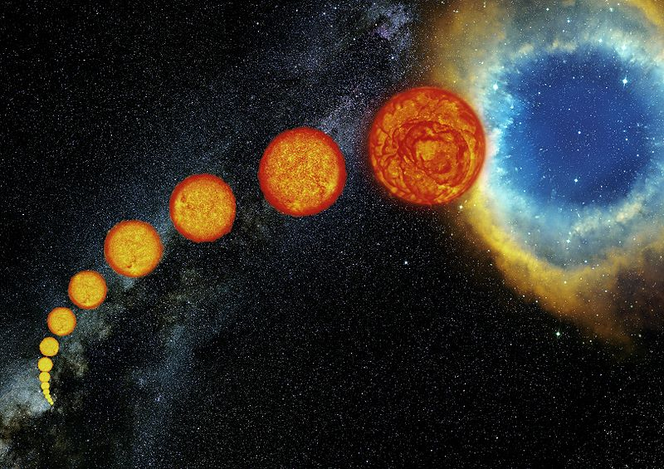
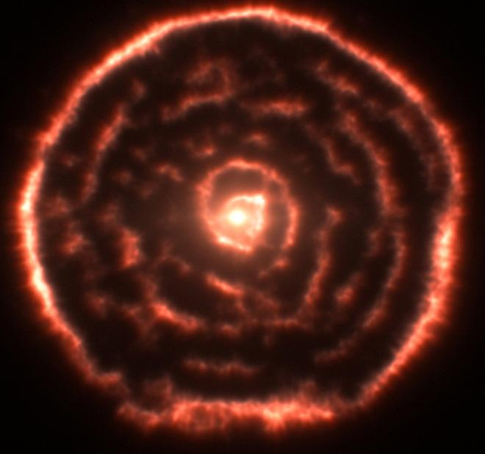
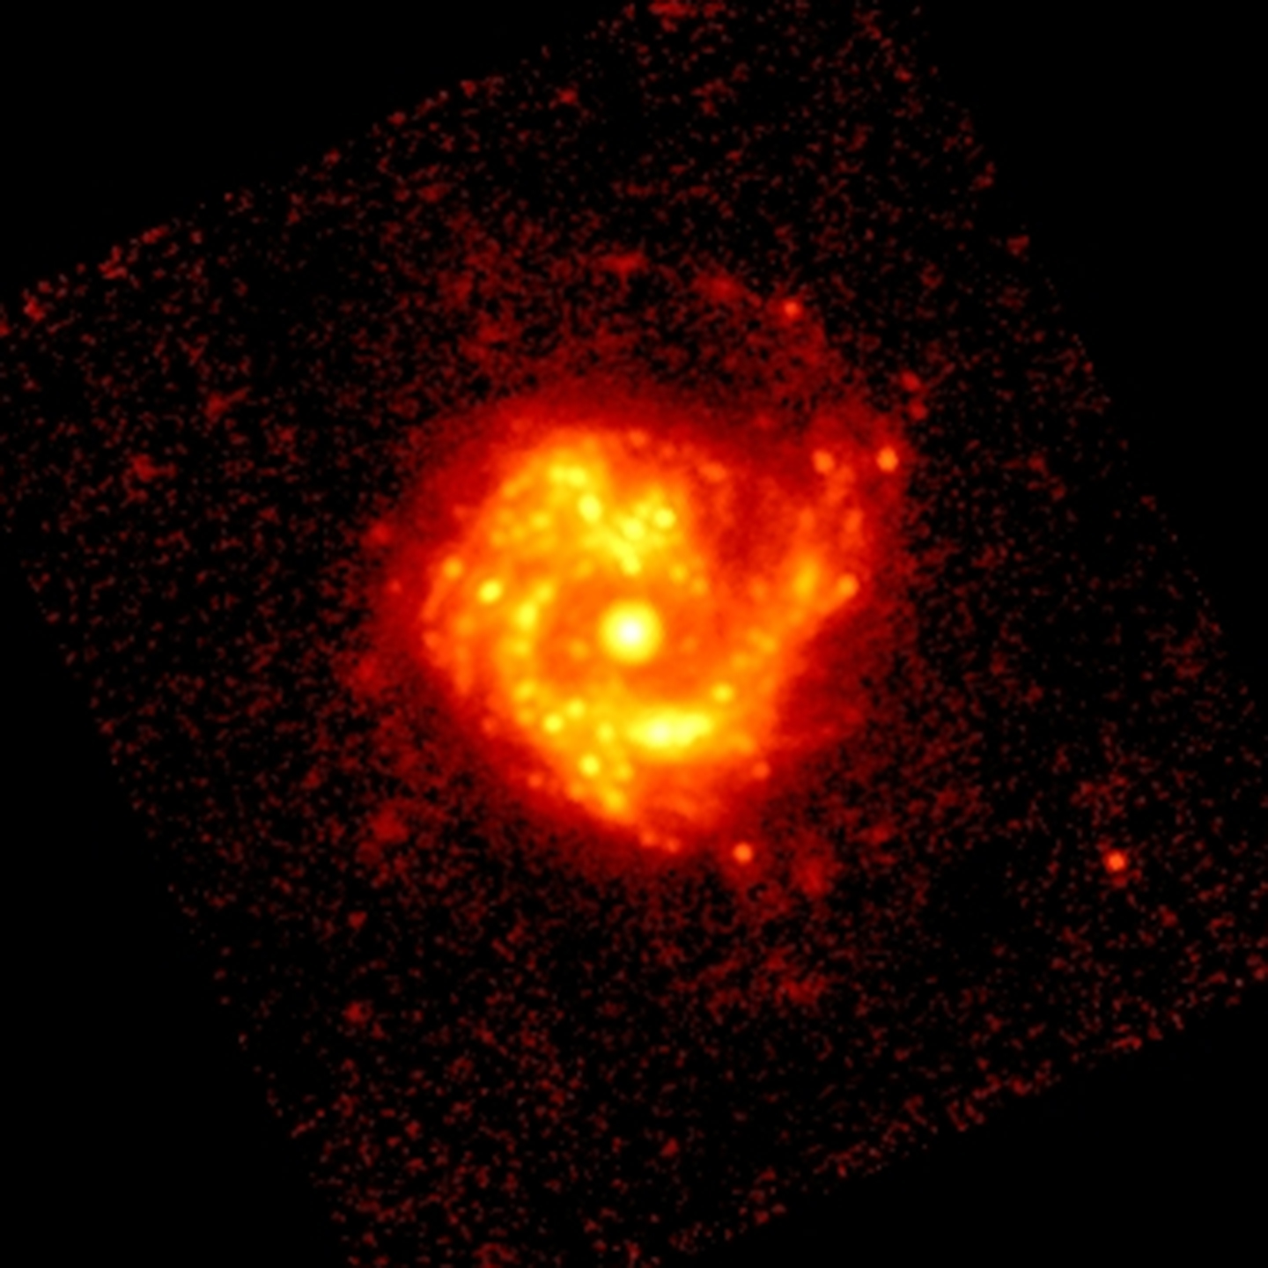
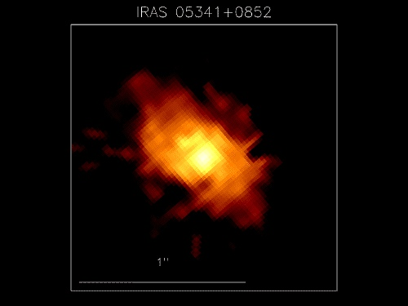
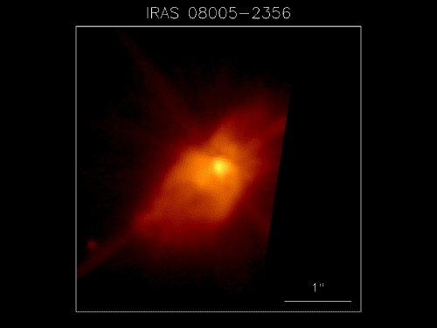
Asymptotic Giant Branch Stars
Understanding the mass loss and dust contribution of AGB and RSG to the ISM

Slide 5
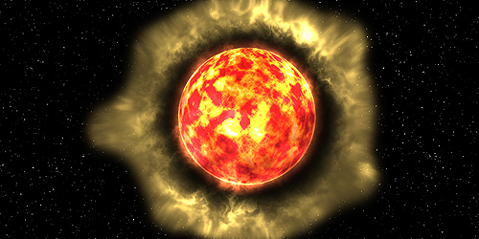
AGB lose 50-80% of mass
Up to 10⁻⁴ solar masses per year
AGB stars may be the largest collective producers of dust in the universe

Slide 7
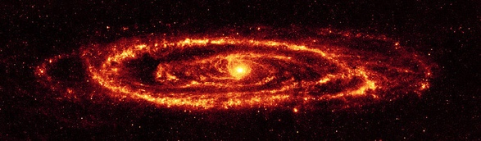

Slide 8
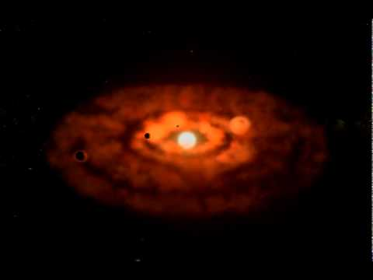

Slide 9
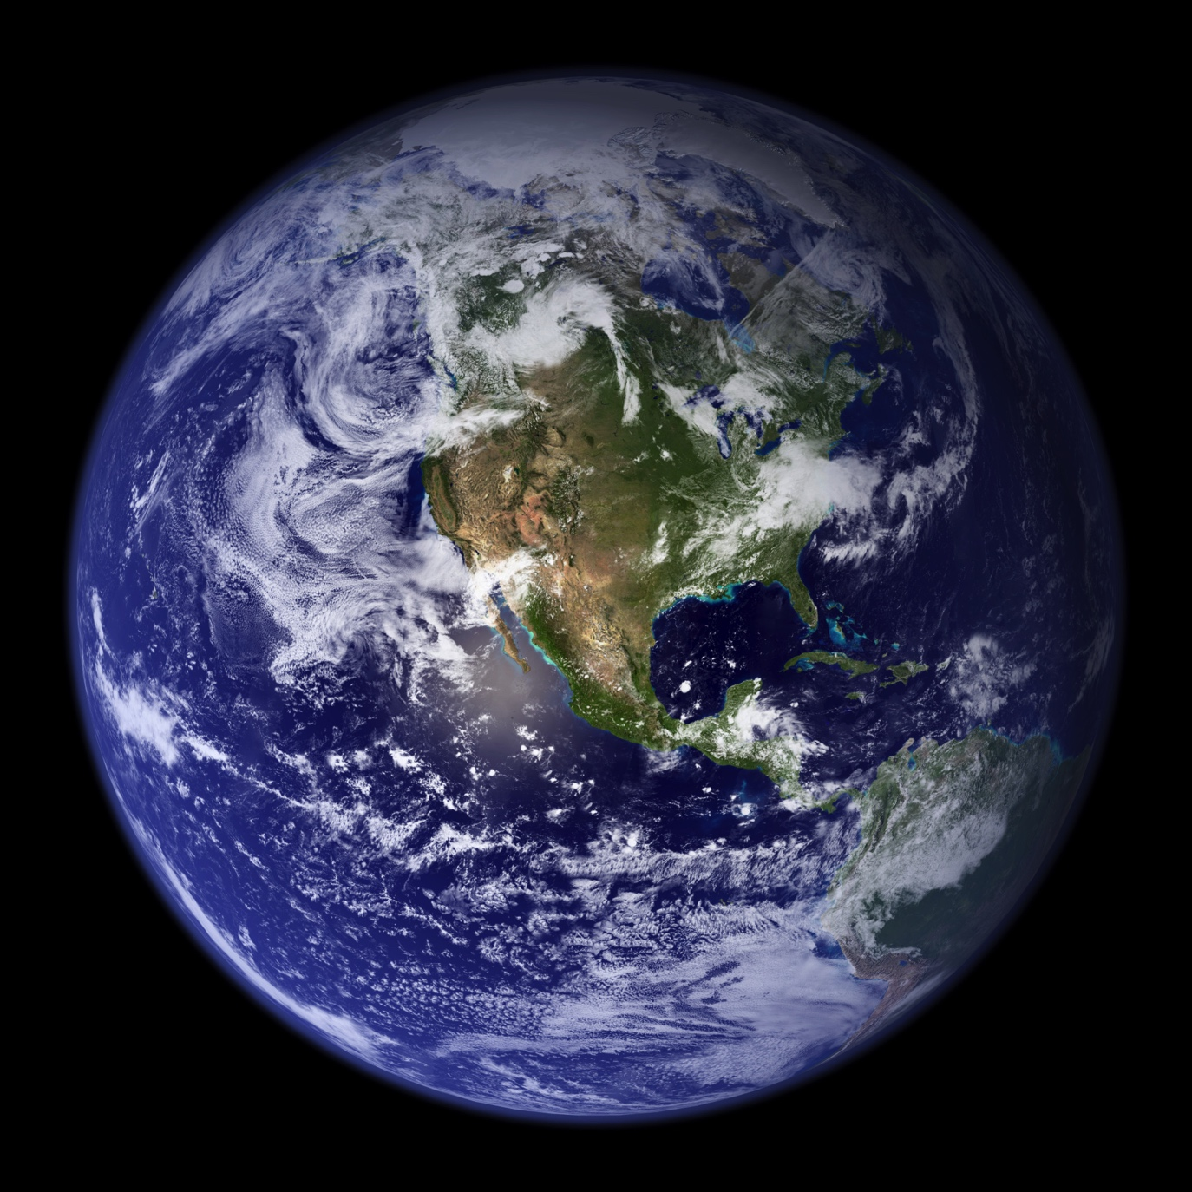

Slide 10
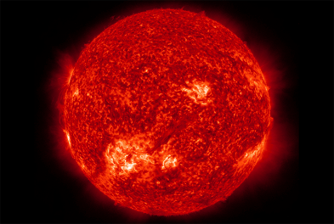
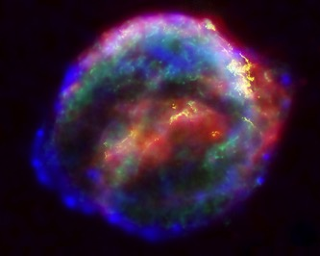
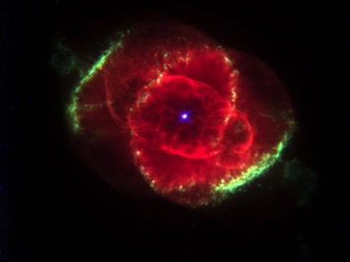
Regeneration of the universe

Slide 11
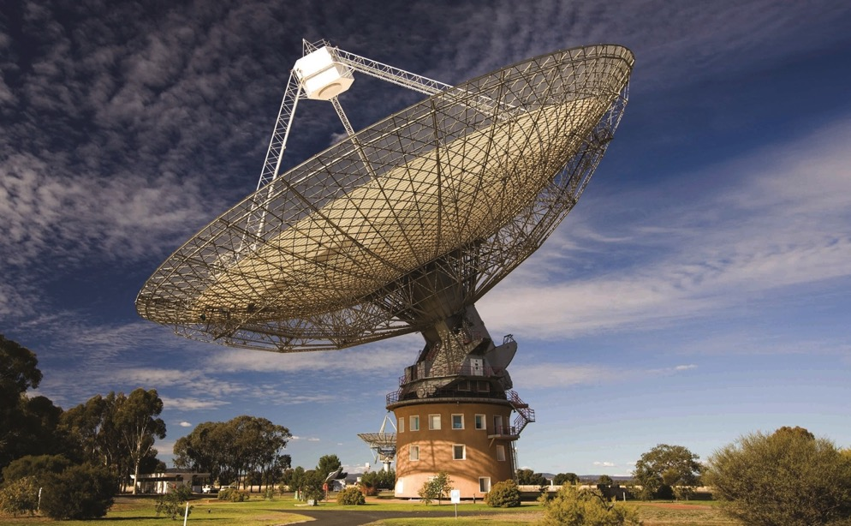
64 m

Slide 12
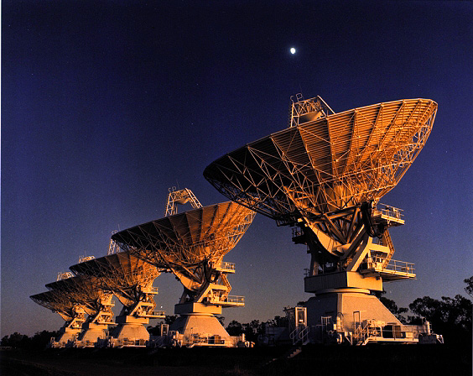
6 x 22 m dishes
longest baseline 6 km

Slide 13
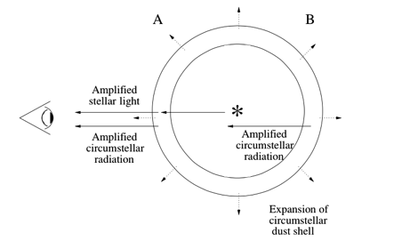
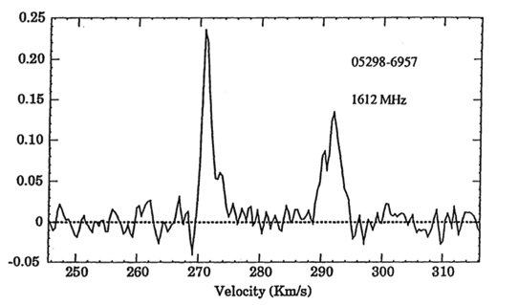
Wood et al. (1992)
Marshall et al. (2004)

Slide 14
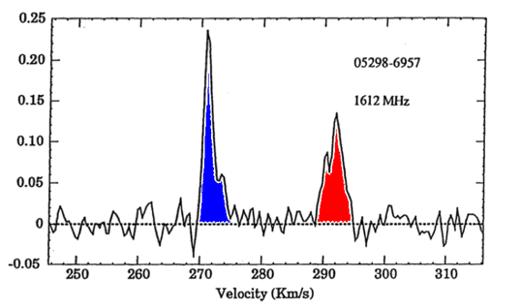
Wood et al. (1992)
Marshall et al. (2004)

Slide 15
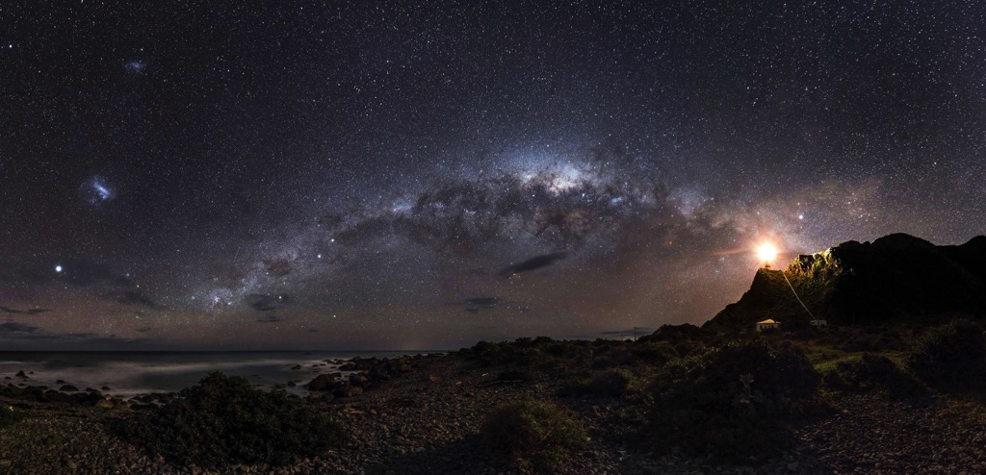

Slide 16
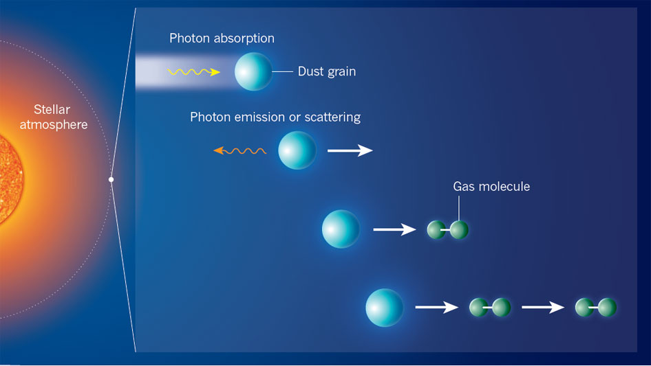

Slide 17
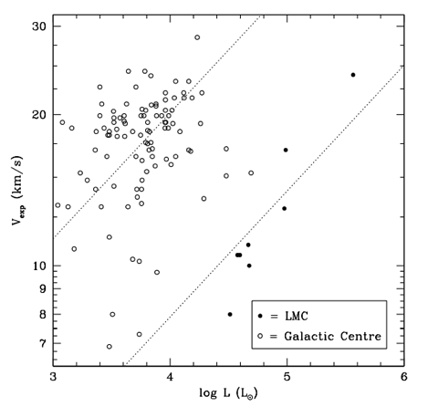
Metallicity and Luminosity
Galactic: >2000
LMC: 8
SMC: 0
GCs: 0
Marshall et al. (2004)

Slide 18
Metallicity and Luminosity
Galactic: >2000
LMC: 8 5
SMC: 0
GCs: 0
Marshall et al. (2004)

Slide 19
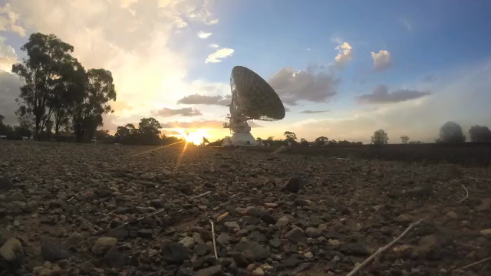
Awarded 92 hours
Four new OH masers
Doubled the number of reliable Vexp

Slide 20
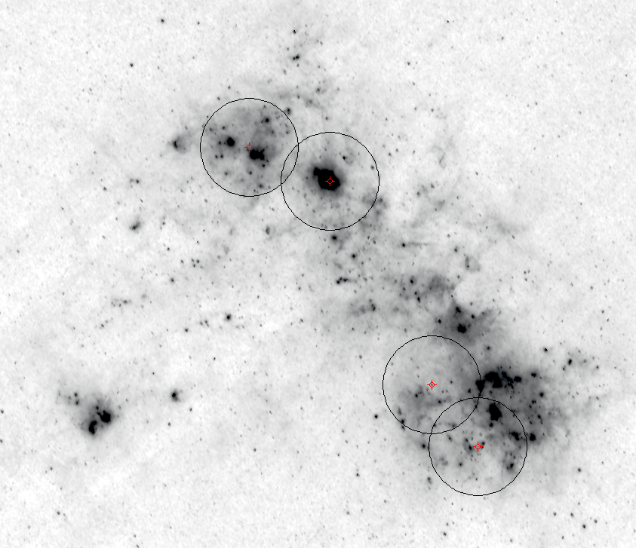

Slide 21
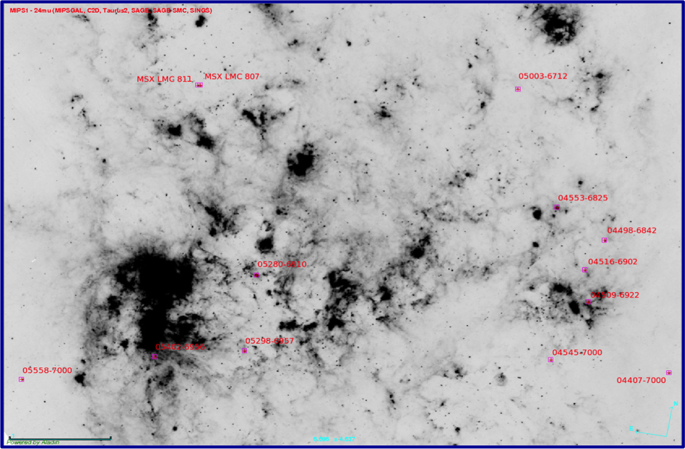
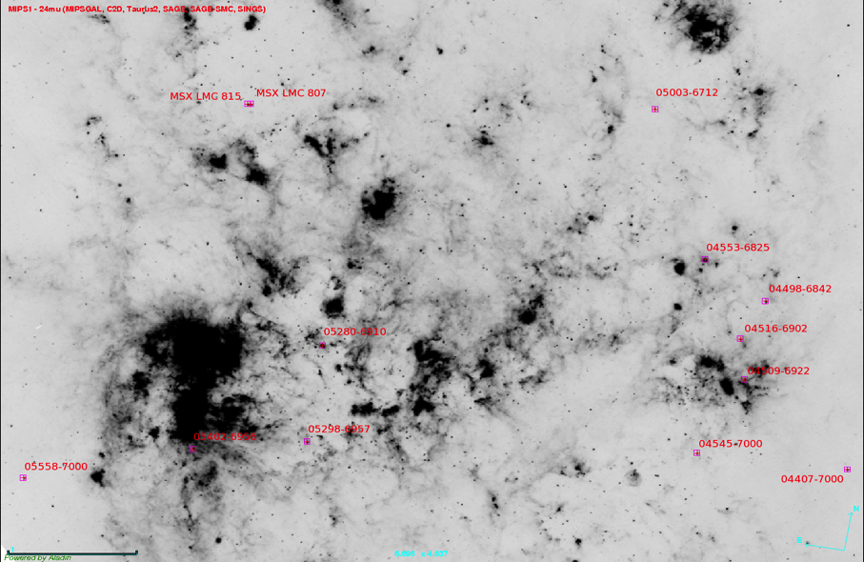

Slide 22
0 masers

Slide 23
Metallicity and Luminosity
Galactic: >2000
LMC: 12
SMC: 0
GCs: 0
Goldman et al. (in prep)

Slide 24
Metallicity and Luminosity
ν_{exp} ∝ ψ^{1/2} L^{1/4}
Galactic: >2000
LMC: 12
SMC: 0
GCs: 0
Goldman et al. (in prep)

Slide 25
Metallicity and Luminosity
ν_{exp} ∝ ψ^{1/2} L^{1/4}
Galactic: >2000
LMC: 12
SMC: 0
GCs: 0
ν_{exp} = 0.13 ψ^{1/2} L^{0.4}
Goldman et al. (in prep)

Slide 26
Metallicity and Luminosity
ν_{exp} ∝ ψ^{1/2} L^{1/4}
Galactic: >2000
LMC: 12
SMC: 0
GCs: 0
ν_{exp} = 0.13 ψ^{1/2} L^{0.4}
Goldman et al. (in prep)
Scaled to galactic samples

Slide 27
Spectral Energy Distribution (SED) Fitting

Slide 28
Goldman et al. (in prep)

Slide 29
Photometry from: 2MASS, DENIS, MSX, AKARI, IRAS, Spitzer
Spitzer phot and Spitzer (IRS) spectra
Best fit DUSTY spectra: dotted line
Blue within 95% confidence
Goldman et al. (in prep)

Slide 30
Photometry from: 2MASS, DENIS, MSX, AKARI, IRAS, Spitzer
Spitzer phot and Spitzer (IRS) spectra
Best fit DUSTY spectra: dotted line
Blue within 95% confidence
Luminosity
Expected expansion velocity
Mass loss rate
Goldman et al. (in prep)

Slide 31
Photometry from: 2MASS, DENIS, MSX, AKARI, IRAS, Spitzer
Spitzer phot and Spitzer (IRS) spectra
Best fit DUSTY spectra: dotted line
Blue within 95% confidence
Luminosity
Expected expansion velocity
Mass loss rate
OH Expected gas-to-dust
8.2 10.8 200
Goldman et al. (in prep)

Slide 32
Photometry from: 2MASS, DENIS, MSX, AKARI, IRAS, Spitzer
Spitzer phot and Spitzer (IRS) spectra
Best fit DUSTY spectra: dotted line
Blue within 95% confidence
Luminosity
Expected expansion velocity
Mass loss rate
OH Expected gas-to-dust
8.2 10.8 200
Goldman et al. (in prep)

Slide 33
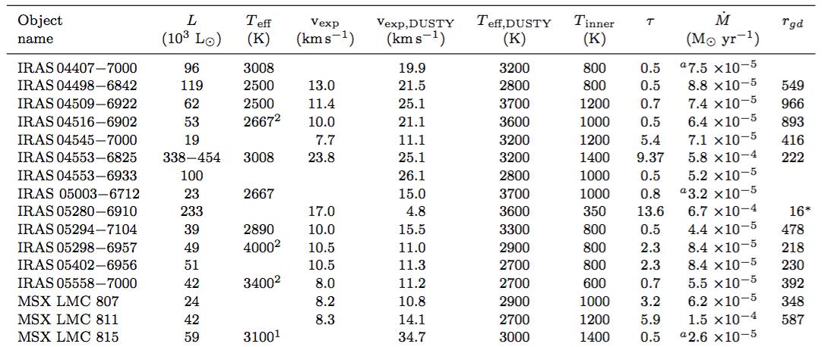
LMC
200
200
200
200
200
200
200
200
200
200
200
380< R_{gd,expected} < 540
R_{gd,median}≈ 405

Slide 34
from OH maser
LMC
DUSTY output
200
200
200
200
200
200
200
200
200
200
200
380< R_{gd,expected} < 540
R_{gd,median}≈ 405

Slide 35
from OH maser
LMC
DUSTY output
200
200
200
200
200
200
200
200
200
200
200
380< R_{gd,expected} < 540
R_{gd,median}≈ 405

Slide 36
from OH maser
LMC
DUSTY output
200
200
200
200
200
200
200
200
200
200
200
380< R_{gd,expected} < 540
R_{gd,median}≈ 405

Slide 37
from OH maser
LMC
DUSTY output
380< R_{gd,expected} < 540
R_{gd,median}≈ 405

Slide 38
from OH maser
LMC
DUSTY output
380< R_{gd,expected} < 540
R_{gd,median}≈ 405

Slide 39
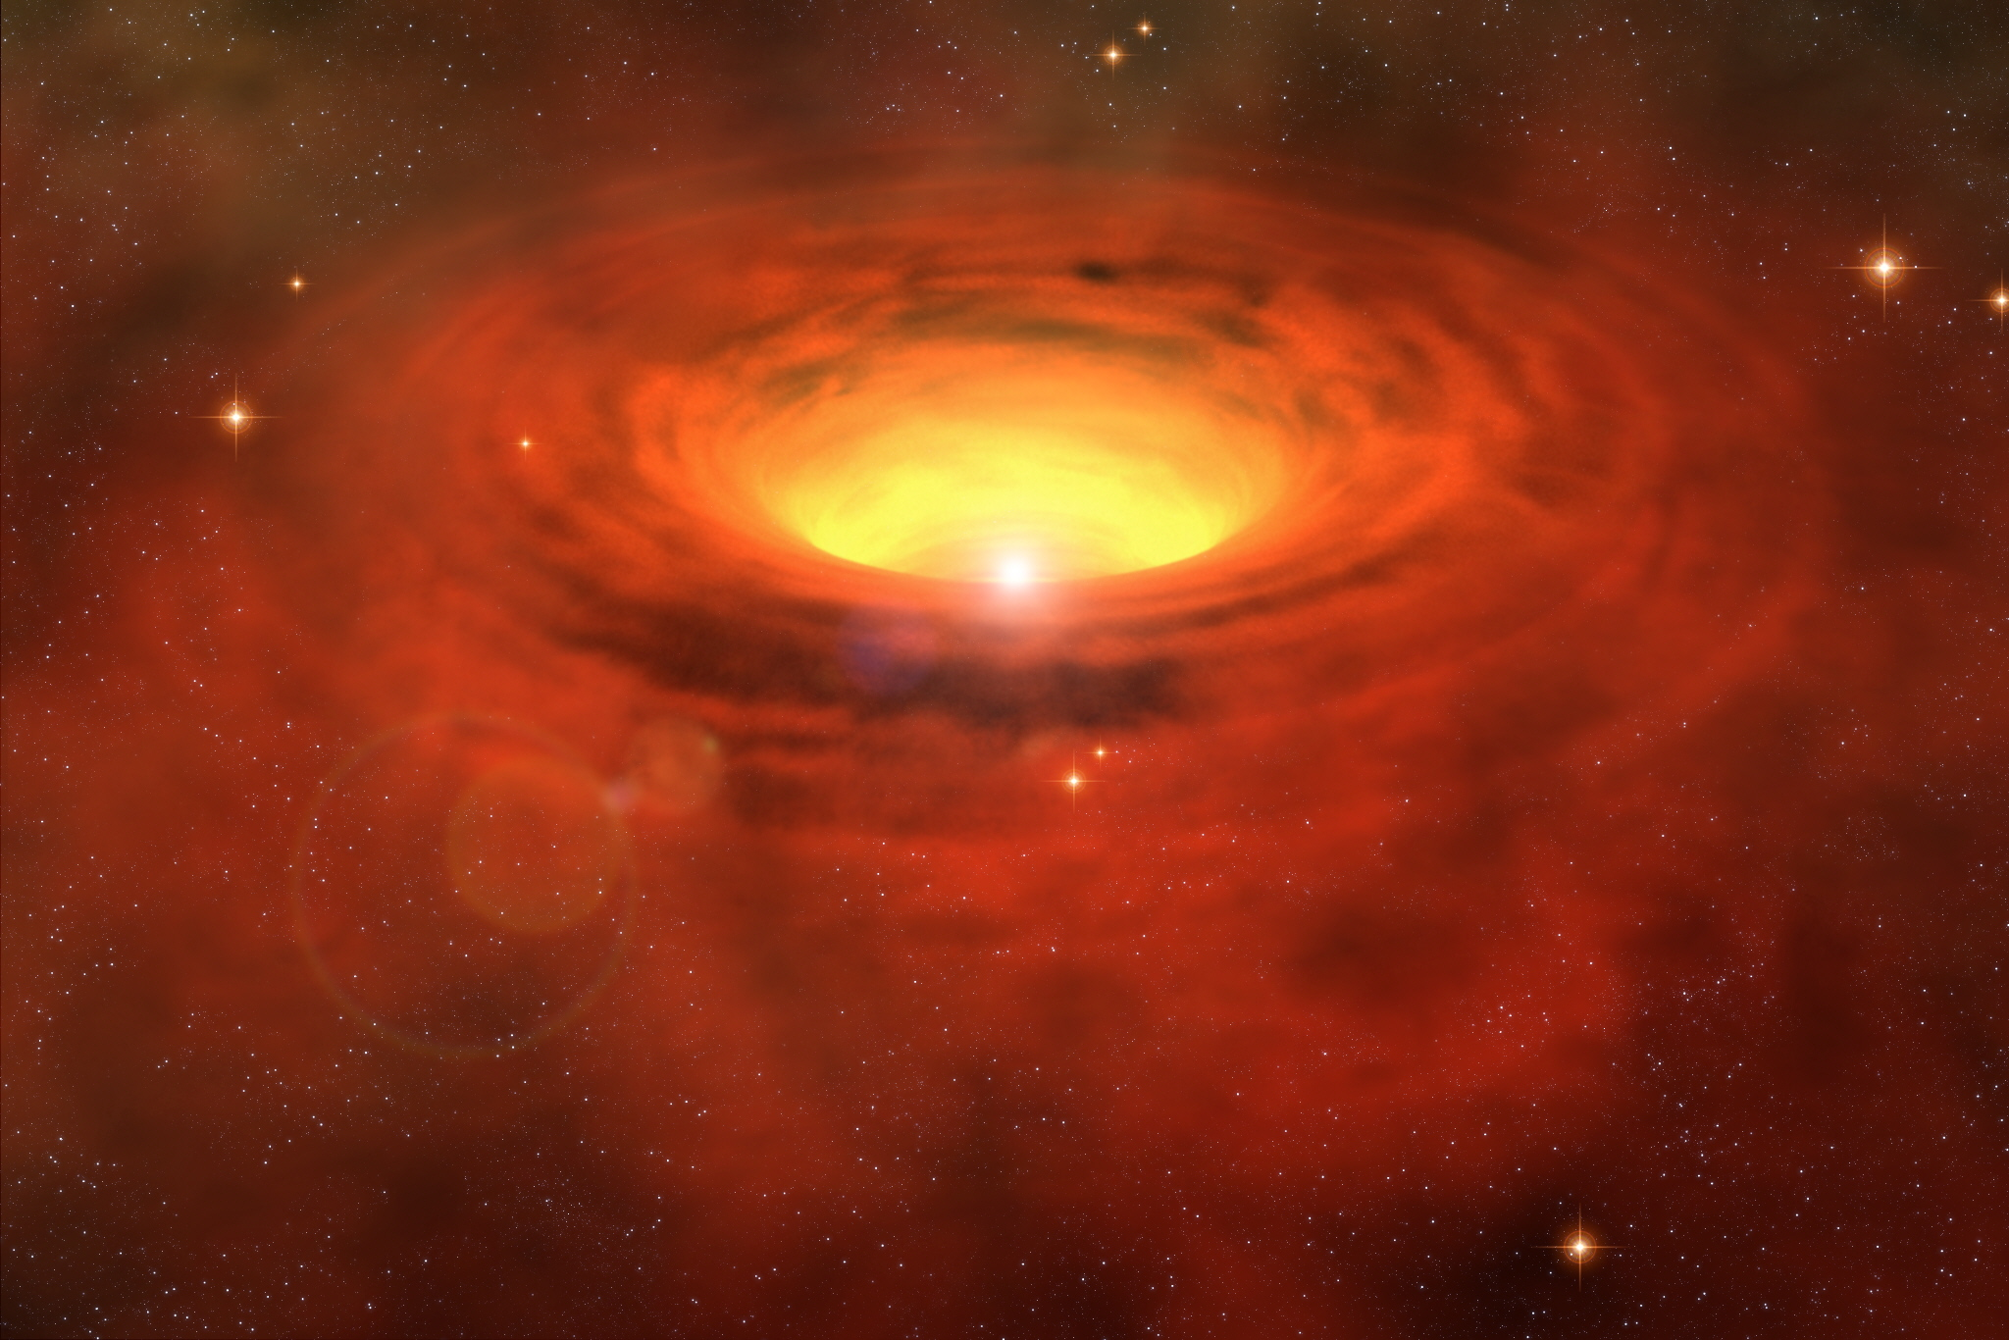
from OH maser
LMC
DUSTY output
380< R_{gd,expected} < 540
R_{gd,median}≈ 405

Slide 40
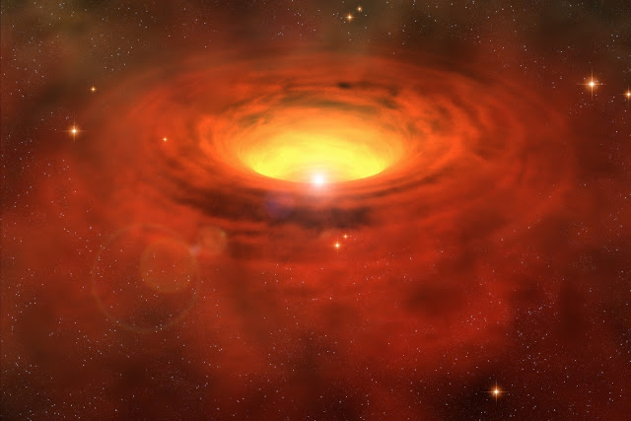

Slide 41
17 km/s
Predicted 4.8 km/s
faster bi-polar outflows
IRAS 05280-6910?

Slide 42
Goldman et al. (in prep)

Slide 43
Goldman et al. (in prep)

Slide 44
Goldman et al. (in prep)

Slide 45
Goldman et al. (in prep)

Slide 46





Mass loss
Reimers 1975
Schroder & Cuntz 2005
van Loon 2005
Baud & Habing 1983
Zijlstra et al. 1996

Slide 47
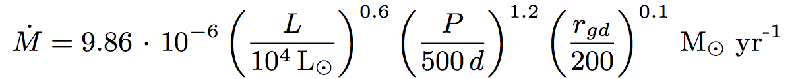
Goldman et al. (in prep)
Goldman et al. (in prep)

Slide 48
Goldman et al. (in prep)

Slide 49
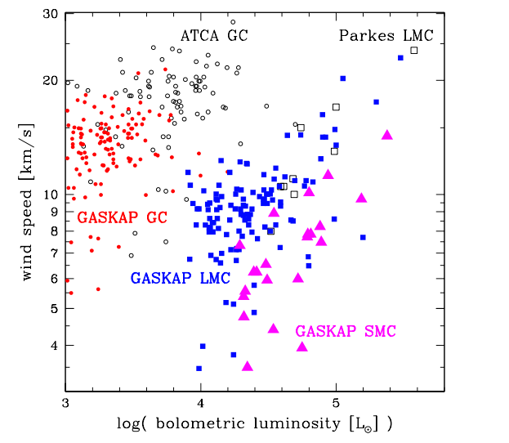
Goldman et al. (in prep)

Slide 50
< 1 km/s spectral resolution
long baselines/high angular resolution
zoom bands (1420, 1612, 1665, 1667, 1720, 2100 MHz)
Goldman et al. (in prep)

Slide 51
The LMC RSG: IRAS 05280-6910

Slide 52
Conclusions
Discovered 4 new circumstellar OH masers
Increased the number of reliable wind speeds from 5 → 12
Developed a method of deriving gas-to-dust ratios (needs testing)
Continue to see a strong dependence on both metallicity and luminosity of expansion velocity
See a strong correlation between luminosity and mass loss
Gas-to-dust ratio has shown to have little effect on the mass loss of AGB and RSGs
This suggests that mass loss is (nearly) independent of metallicity between a half and twice solar

Slide 58
ν_{exp} ∝ ψ^{1/2} L^{1/4}

Slide 59
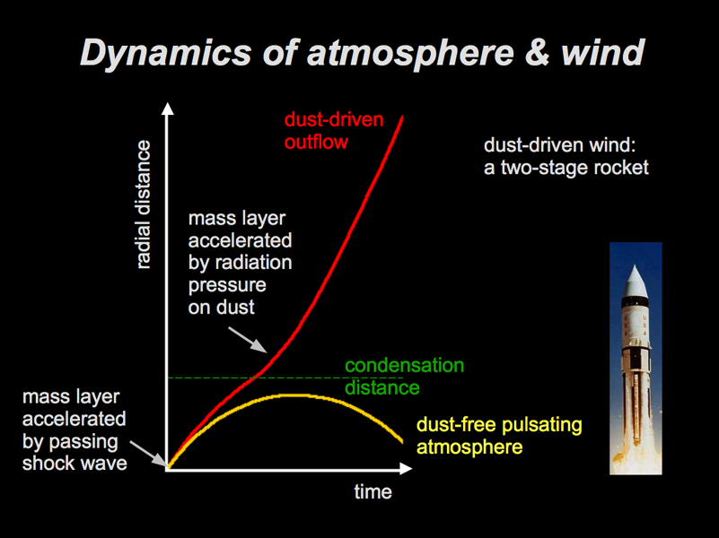
S. Höfner

