Slide 1
Signal and Data Transport for the SKA UK SKA Science Meeting, Cambridge 12th April 2016
Keith Grainge, SADT Lead University of Manchester

Slide 2
SADT Consortium
Consortium Board, chair: Huib Jan van Langevelde
Lead institute: University of Manchester
Leader: Keith Grainge
Project Manager: Jill Hammond
System Engineer: Rob Gabrielczyk
Project Engineer (SADT): Richard Oberland
Element specialist (SAT): Simon Garrington
Full members
JIVE (Netherlands)
NPL (UK)
NCRA (India)
NMMU (South Africa)
CSIRO (Australia)
IT (Portugal)
SANREN (South Africa)
SKA Africa (South Africa)
Tsinghua University (China)
UWA (Australia)
University of Granada (Spain)
AARNet (Australia)
GÉANT (EU)
Associate members
…and industrial partners

Slide 3
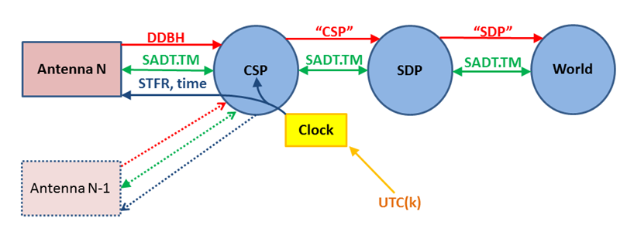
SADT summary
Science Data
DDBH
CSP-SDP
SDP to world
Sync & Timing
Clock ensemble
Freq. & Phase
UTC time
Non-Science Data
Control & Monitor
Alarms
Internet, VoIP
“Spanning” Tasks: Network Architecture; Network Manager;
Local Infrastructure
CSP-SDP
NSDN
NSDN
NSDN

Slide 4
Big Data Challenge

Slide 5
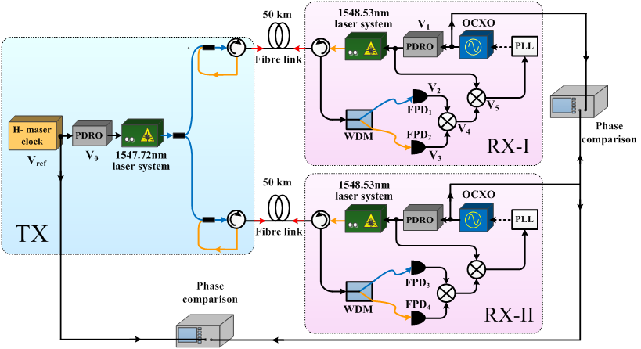
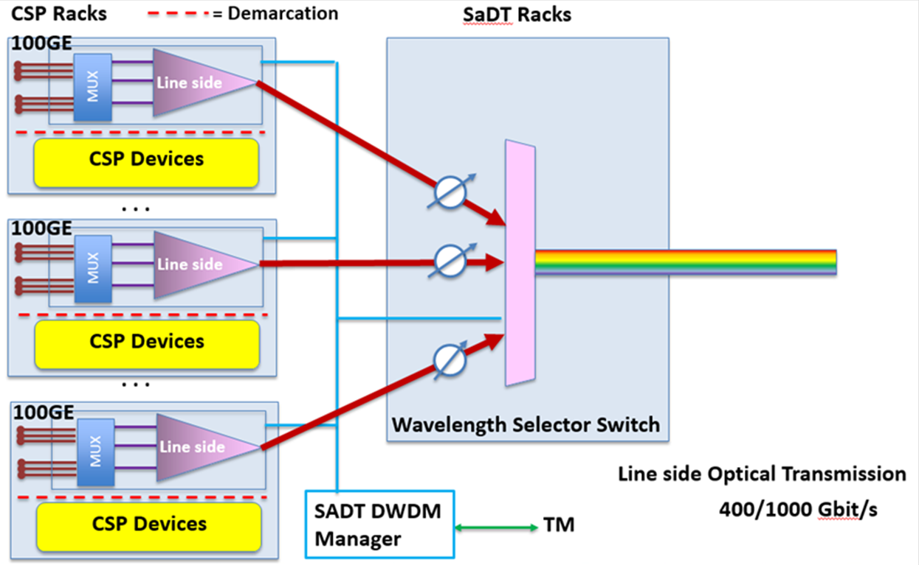
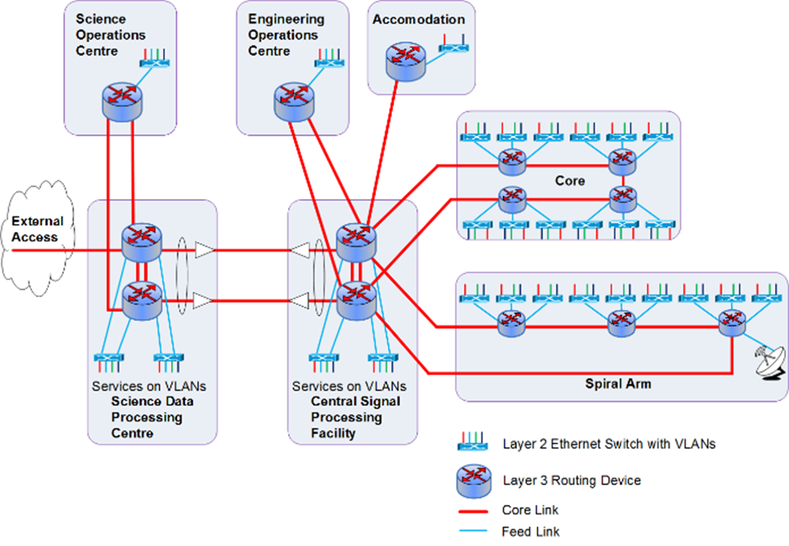
SADT Technical Solutions
SAT
3 H-maser clock ensemble
“There-and-back” STFR
White Rabbit time distribution
Digital Data Backhaul
COTS solutions
Multiple vendors approached
Trended costs estimated
NSDN
COTS solution
Some redundancy
Issues: scope; security
LINFRA
Most expensive component

Slide 6
Cost estimates
2013 bid estimate: €435M
SADT: 90M€ of 855M€ cost cap; project cost cap 650M€
SADT input to RBS: €99.3M; cost model supplied to SKAO
SKAO issued Budget after RBS: €32.4M
Increase in SADT scope (e.g. NSDN)
SADT cost estimate Jan 2016: €76M – 134% over-budget!!!
But, Budget did not include:
NSDN (~10M)
Installation of Carnarvon to Beaufort West fibre in SA (~10M)
Trenching on both sites (assumed to be provided by INFRA; ~10M)
SADT Contingency using TMT model (~10M)

Slide 7
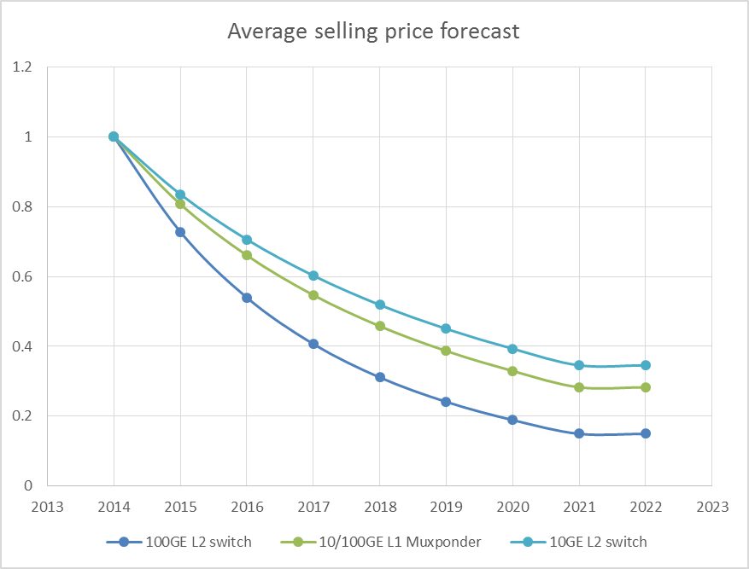
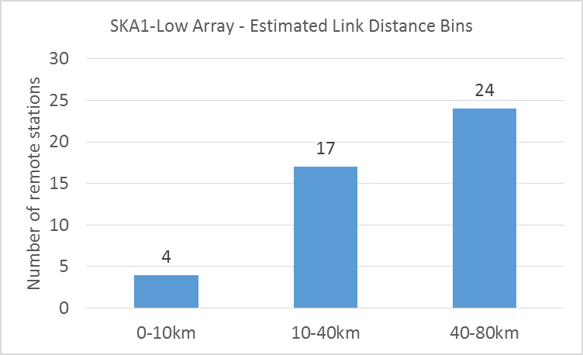
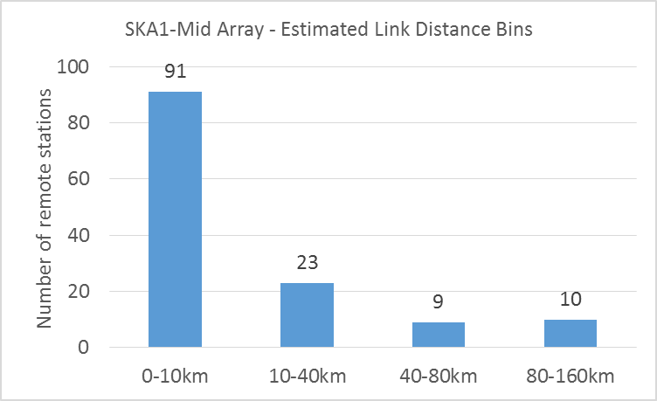
DDBH COTS Cost estimation
Fractional selling price drop per annum
Estimates cable routed distance bins BDv2
Cost / power function of :
Year deployed (roll-out)
Data capacity
Cable distance

Slide 8
Tsinghua STFR system
Maintain interferometer coherence; 1ps accuracy
Active, “Round-trip”, reference frequency distribution

Slide 9
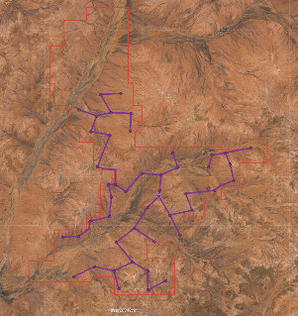
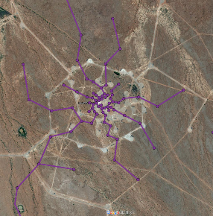
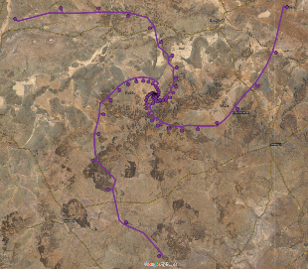
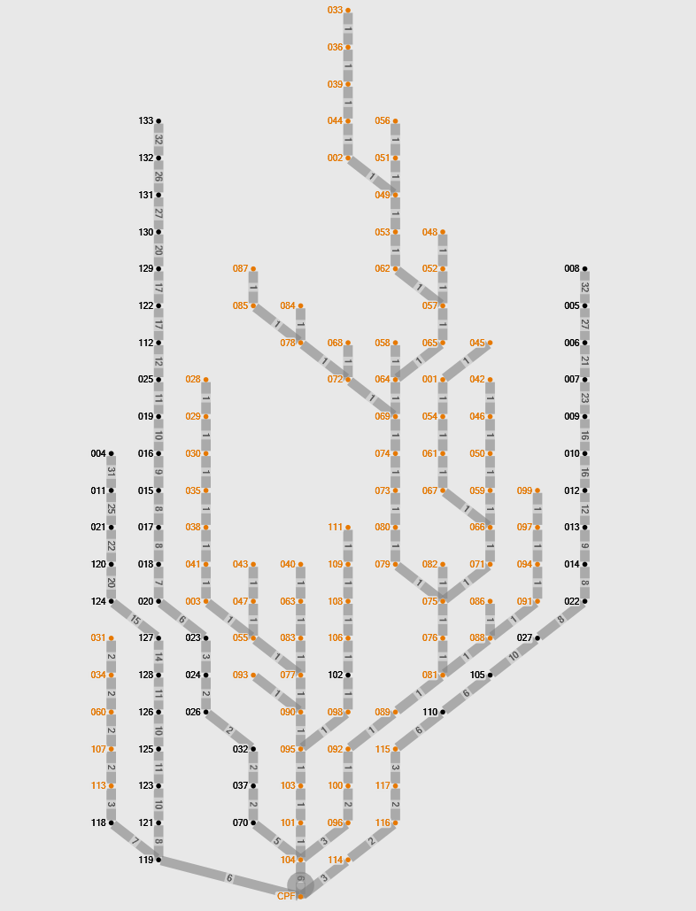
LINFRA - cable routing to CPF
Cable route distance optimised examples
Australia
SKA1-Low Outer array
South Africa
SKA1-Mid Inner Array
South Africa
SKA1-Mid Outer Array

Slide 10
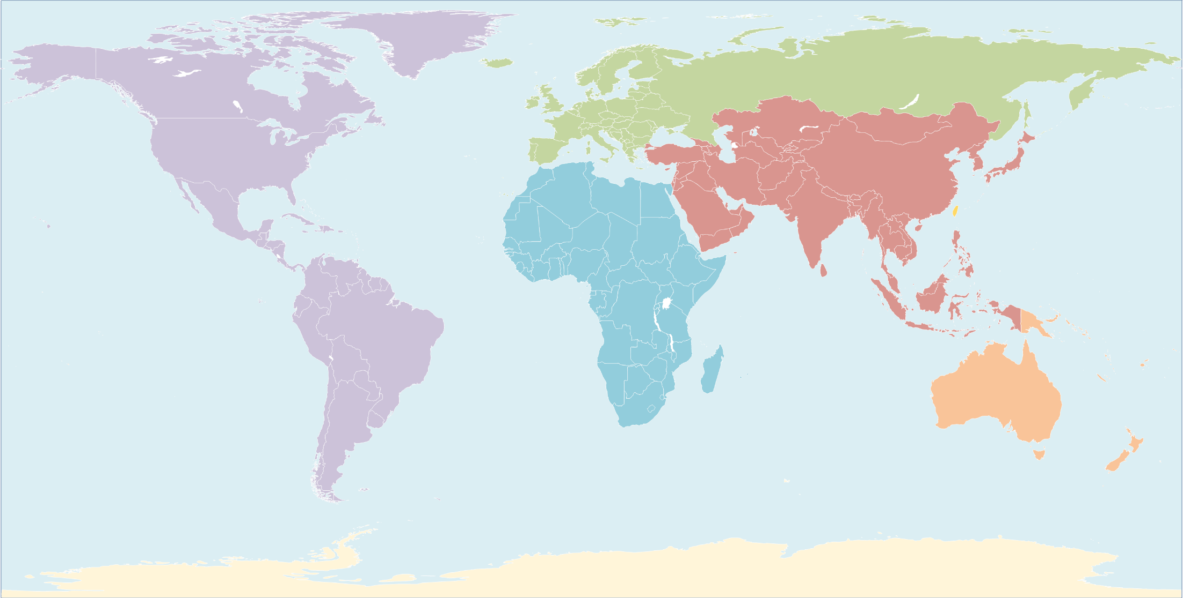
Estimated SDP to world costs
10 year IRU per 100Gbit circuit 2020-2030
Assumes Regional Centres; guestimate of locations
US$.1M/Year
US$.1M/Year
US$.5-2M/Year
US$1-3M/Year
US$.2-.5M/Year
US$1-2M/Year
US$.5-2M/Year
US$1-3M/Year
US$1-3M/Year
Guesstimate of
Regional Centres
Notes:
Centre locations are guesses – no SKA board decisions
Network costs have input from current 100 Gigabit and 10 Gigabit contracts with reasonable projections

Slide 11
Raw visibility data rates
$\frac{n\left(n−1\right)}{2}$ baselines; full Stokes
Maximum $t_{corr}$ and $\frac{Δν_{chan}}{ν_{RF}}$ set by smearing
Dependence on $D_{ant}, d_{baseline}$
Complex single precision + header → 80bits
Transporting raw visibilities ~ €500M / year
1 day’s data ~ 100 PB; storage ~ €2M (2023)
Processing this data also an “issue”

Slide 12
Summary
SADT delivers the “backbone” for the SKA
A Big Data problem; huge data rates
SADT detailed design well underway
Largely COTS solutions
STFR is the exception
Prototyping last year and this summer
Requirements still evolving
Significant industrial engagement

Slide 13
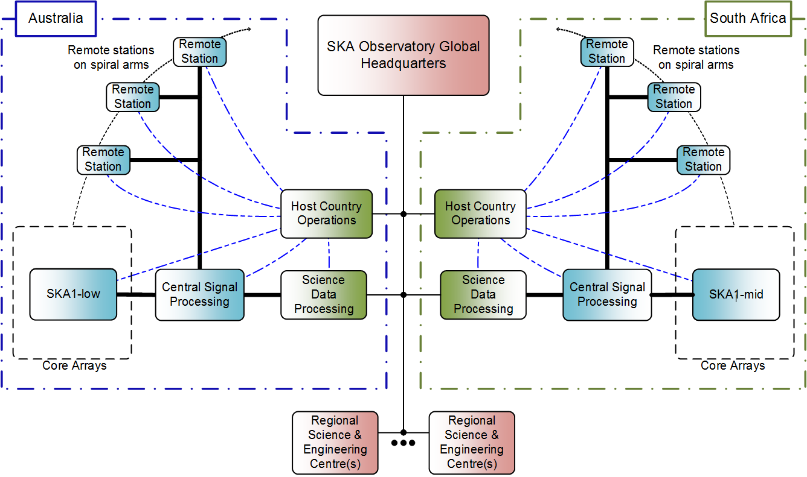
Effect of RBS, ECPs
0.7→3.2 Tb/s
5.1→4.5 Tbps
13.9→15.2 Tbps
100Gb/s
100Gb/s
(15→7.2Tbps)
59→3.1Tbps
27→4.9Tbps
SKA1_Low
SKA1_Mid
()* – if digitised
Notes:
Continuous data flows through the instrument:
Remote stations up to 150 km away – but the fibre paths are longer.
Core ~ 2-5 km
CSP-SDP ~ 900 km
Telescope – world baseline: 100 Gb/s for transporting the data products to the Regional Science Centres around the world.
Science rates – no meta-data: SKA1_Low = 3.7 SKA1_Mid = 4.1
Main effects od RBS are due to:
Deferring SKA1_Survey
Reducing the number of stations and dishes
Reducing the number of frequency bands
CSP-SDP required metadata now included in Re-Baselining
Pulsar beams in SKA1_Low and SKA1_Mid

