Slide 1
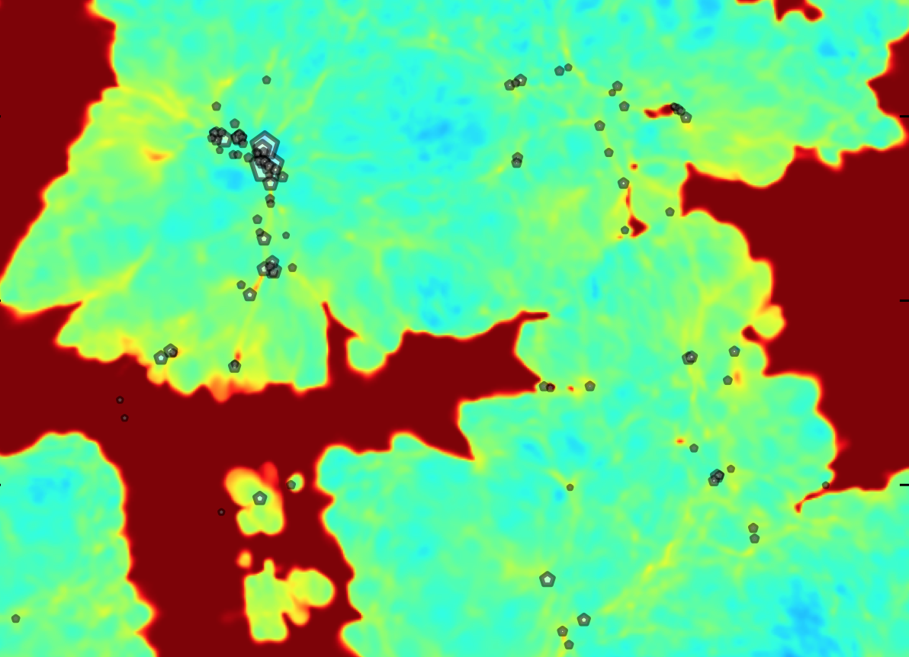
21cm predictions in reionization
models calibrated with Lya
forest data
Martin Haehnelt
Dominique Aubert
James Bolton
Jonathan Chardin
Tirth Choudhury
Harley Katz
Laura Keating
Taysun Kimm
Girish Kulkarni
Ewald Puchwein
Alberto Rorai

Slide 2
Probing the Epoch of Reionization
Robertson et al.
CMB
Lyman-alpha absorption
Lyman-alpha emitters/high redshift galaxies
21cm emission/absorption

Slide 3
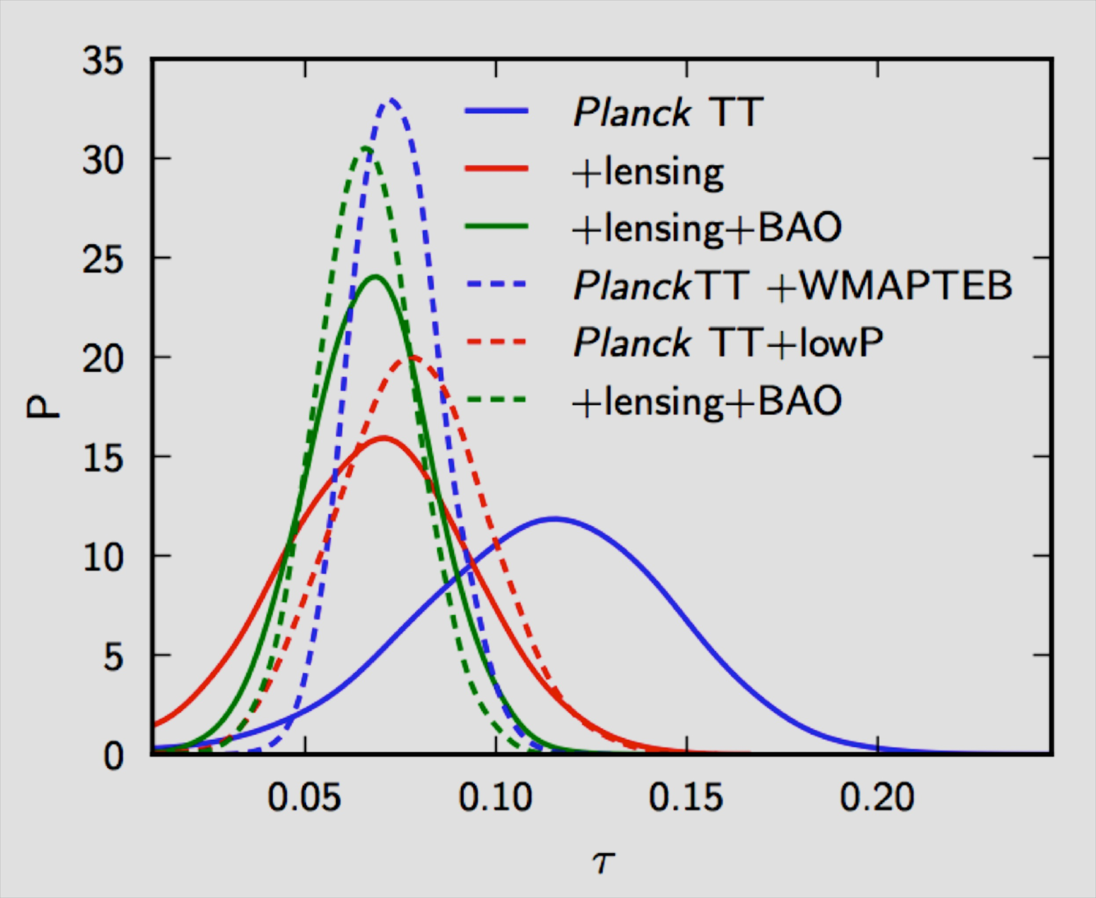
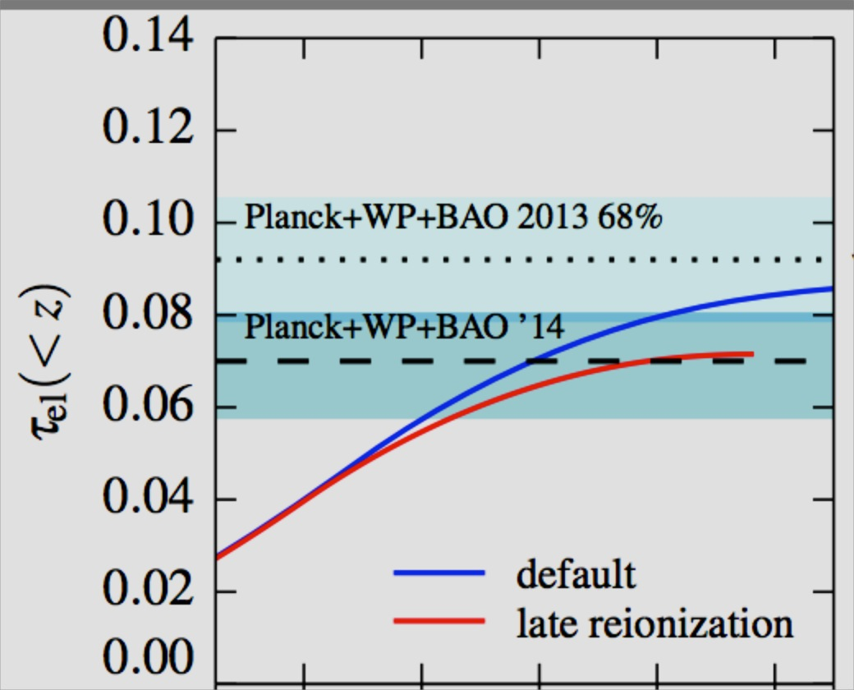
The Planck 2015 results for τ
Planck 2016?
(HM 2012)
constraints from CMB have become very weak.
joint constraint with BAO appears to come down
Planck 2016 → very late and fast reionization?

Slide 4
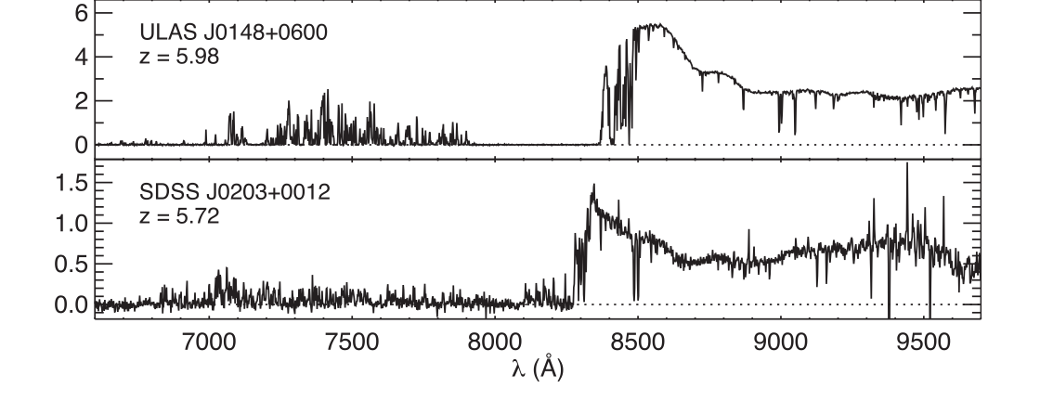
110h⁻¹Mpc
Becker et al. 2015
There are large fluctuations of the optical depth on surprisingly
large scales.
Are there are still large completely neutral regions even at z~5.5?

Slide 5
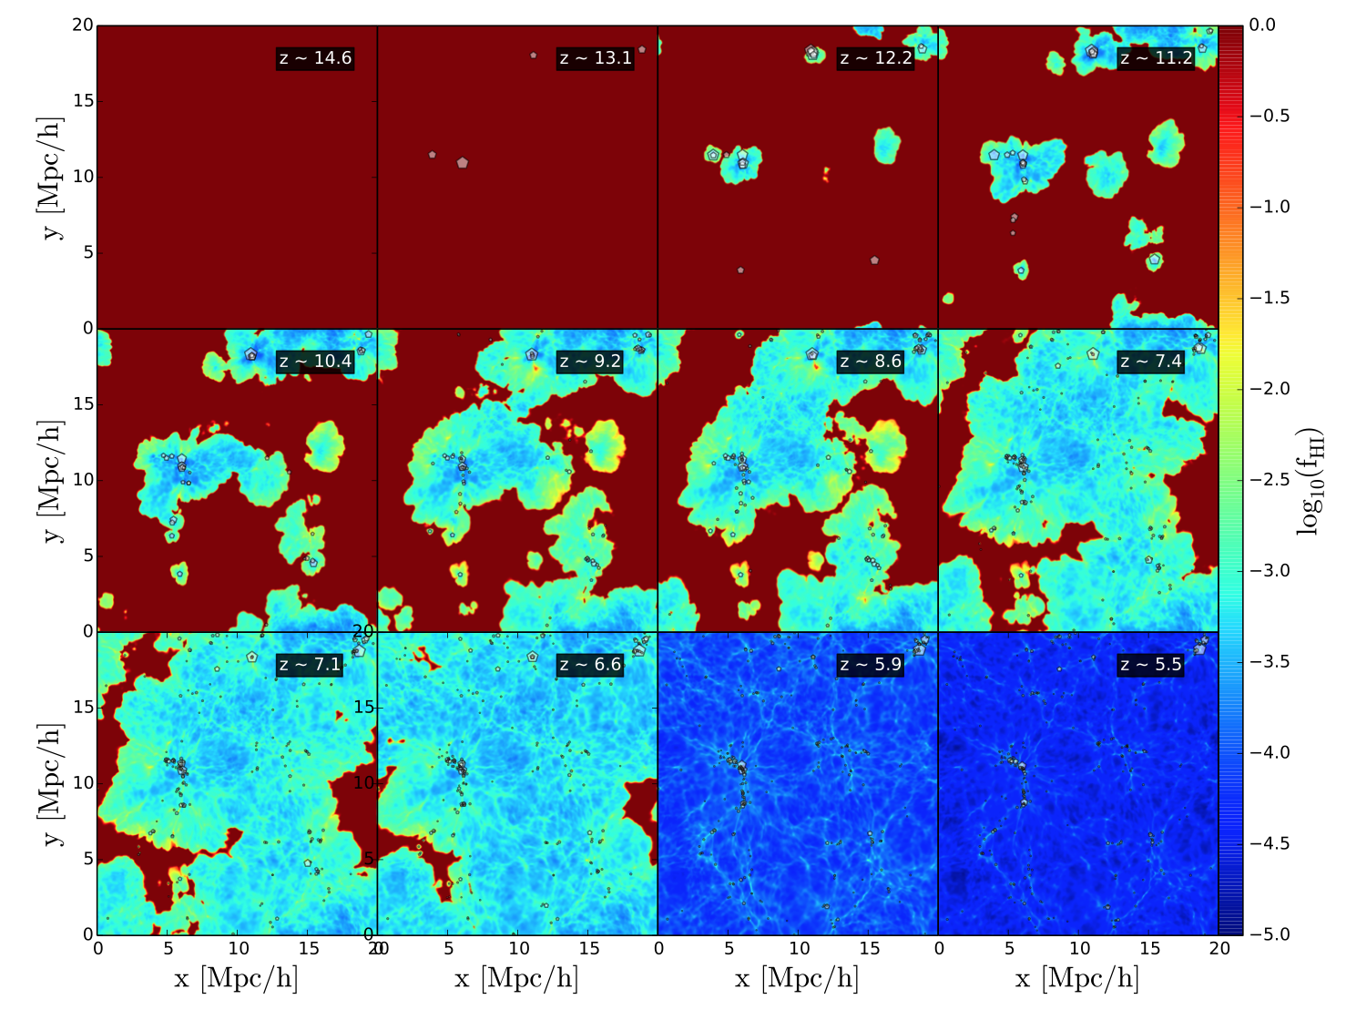
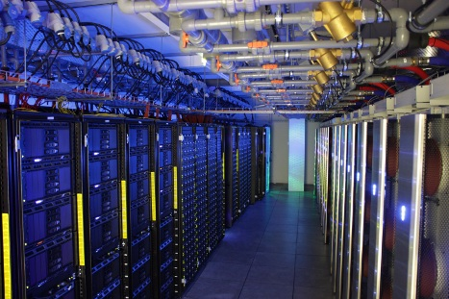
RAMSES
post-processed
with
ATON
WILKES: 256 NVIDIA GPUs
240 Teraflops, fastest
academic computer in UK
second in Green 500
Carefully
calibratted
with Lyα
forest data
Chardin, Haehnelt, Aubert & Puchwein 2015

Slide 6
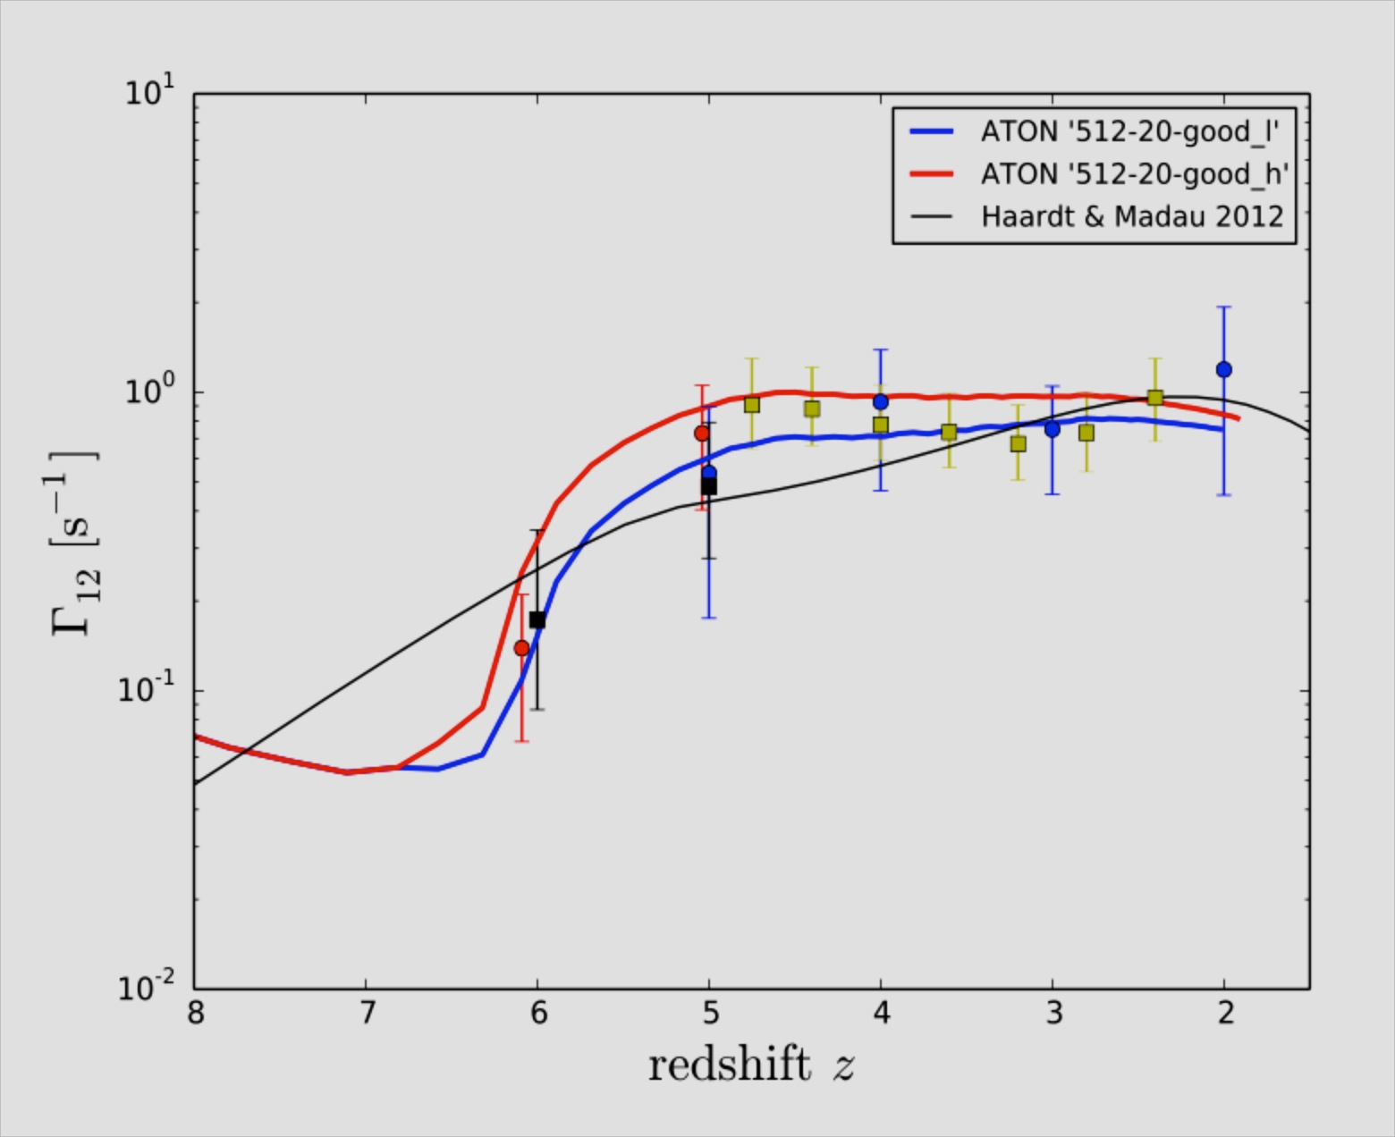
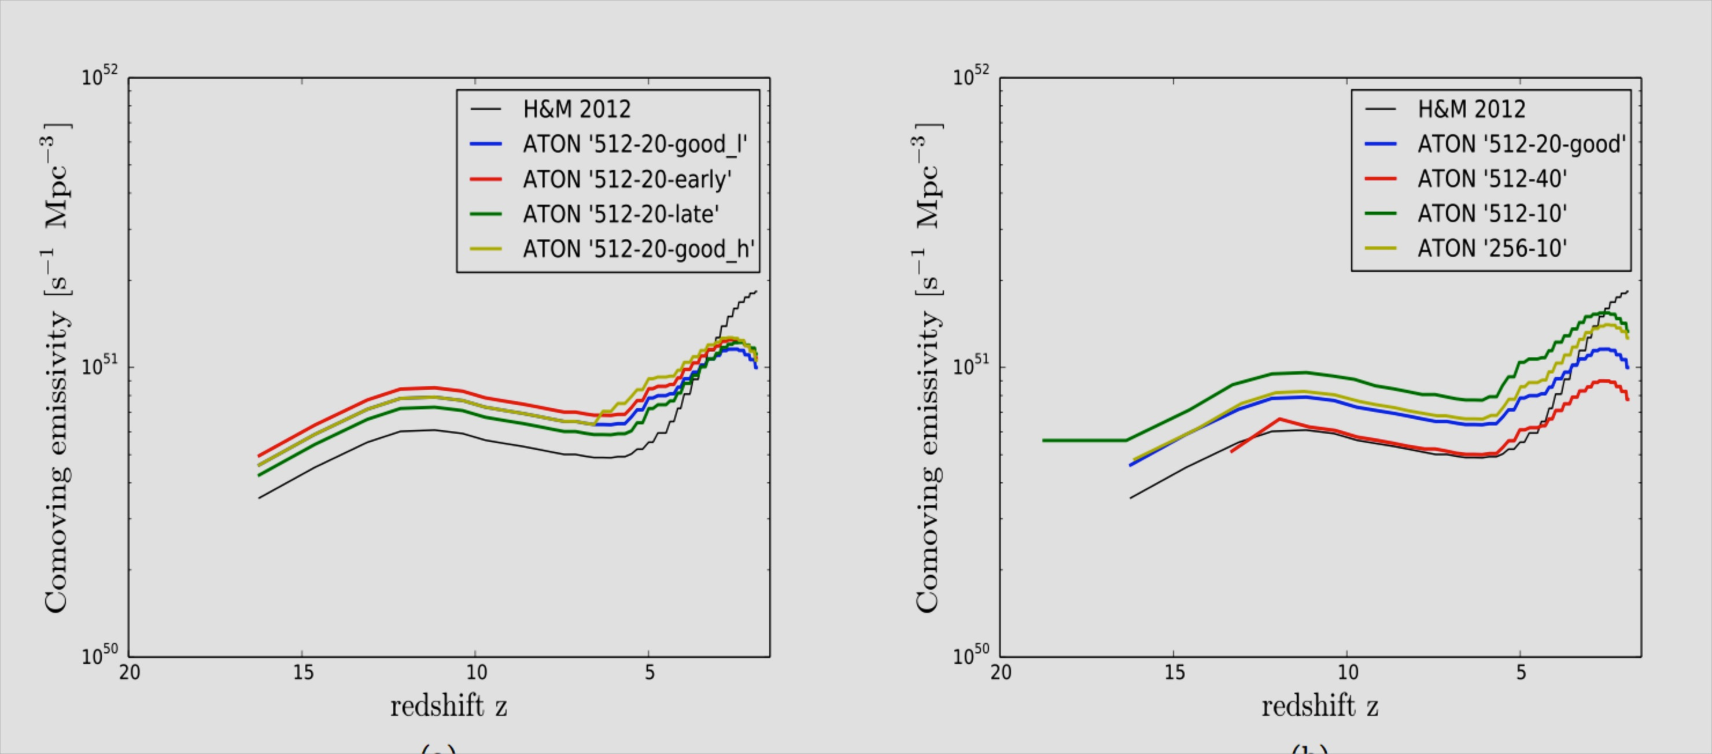
photo-ionization
rate
ionizing
emissivity
Chardin et al. 15
Photo-ionization rate well reproduced with somewhat
modified ionizing emissivity compared to HM2012.

Slide 7
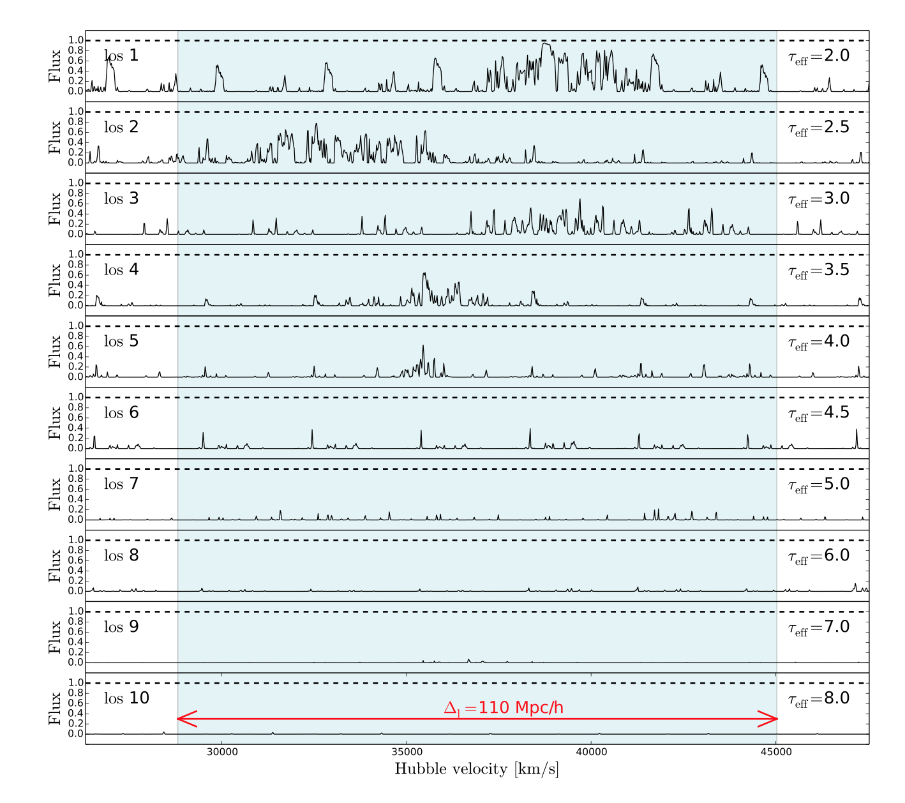
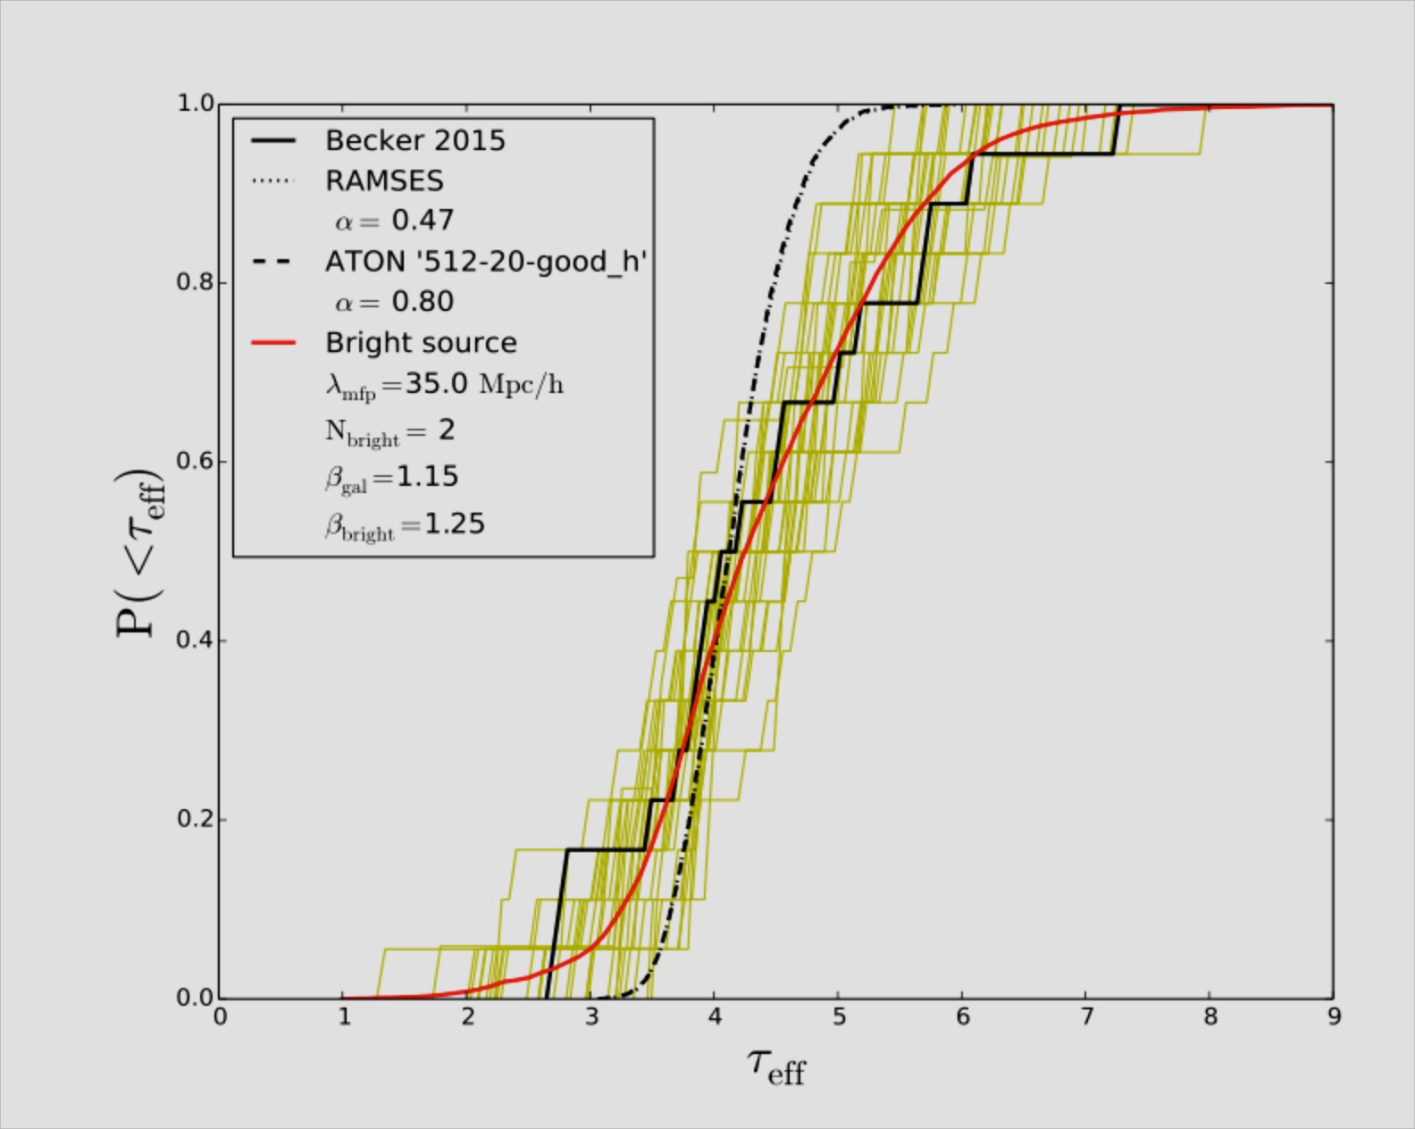
12
Opacity fluctuation on large sclaes → QSOs?
Chardin et al. 16

Slide 8
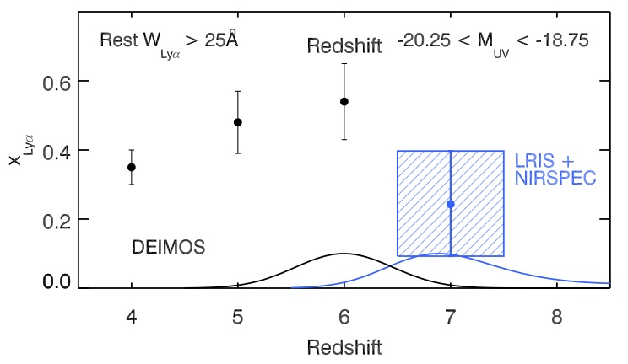
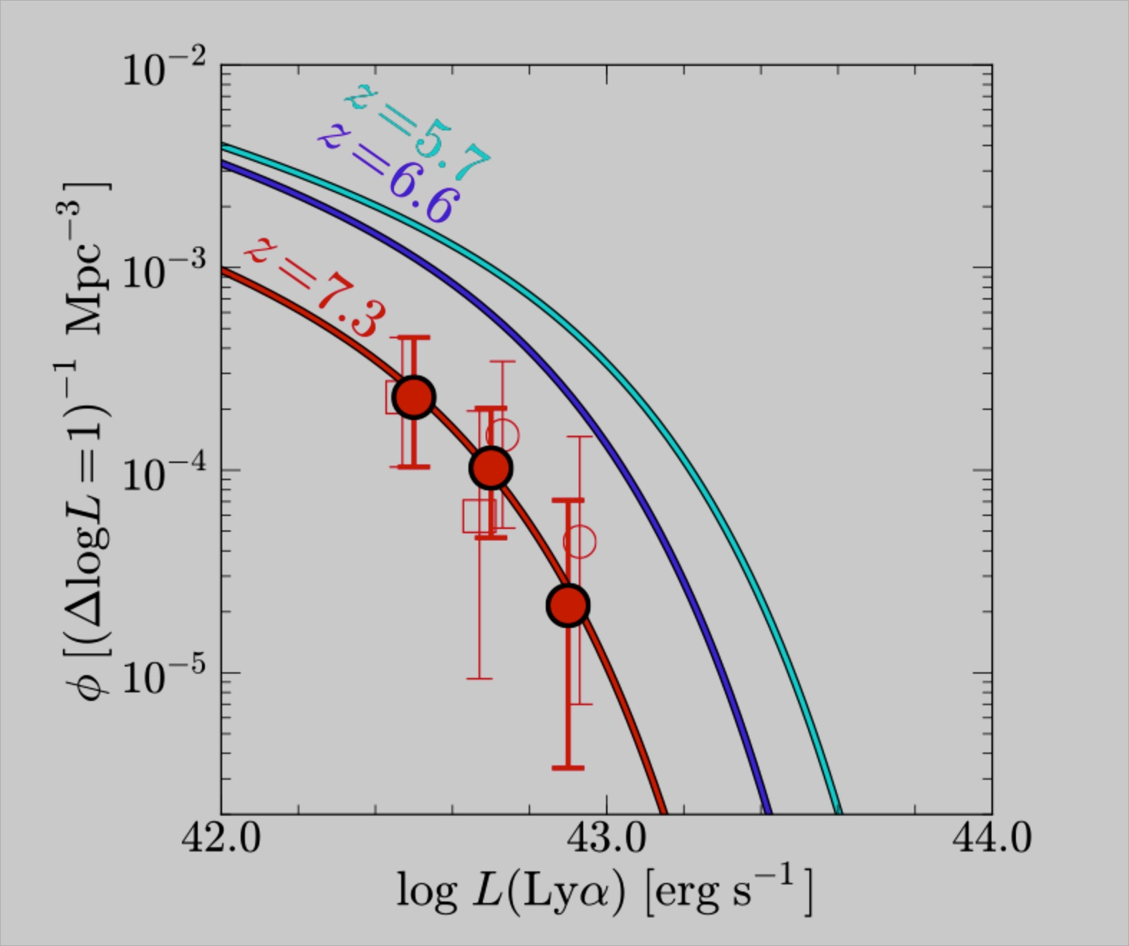
Stark 2011
Konno et
al. 2014

Slide 9
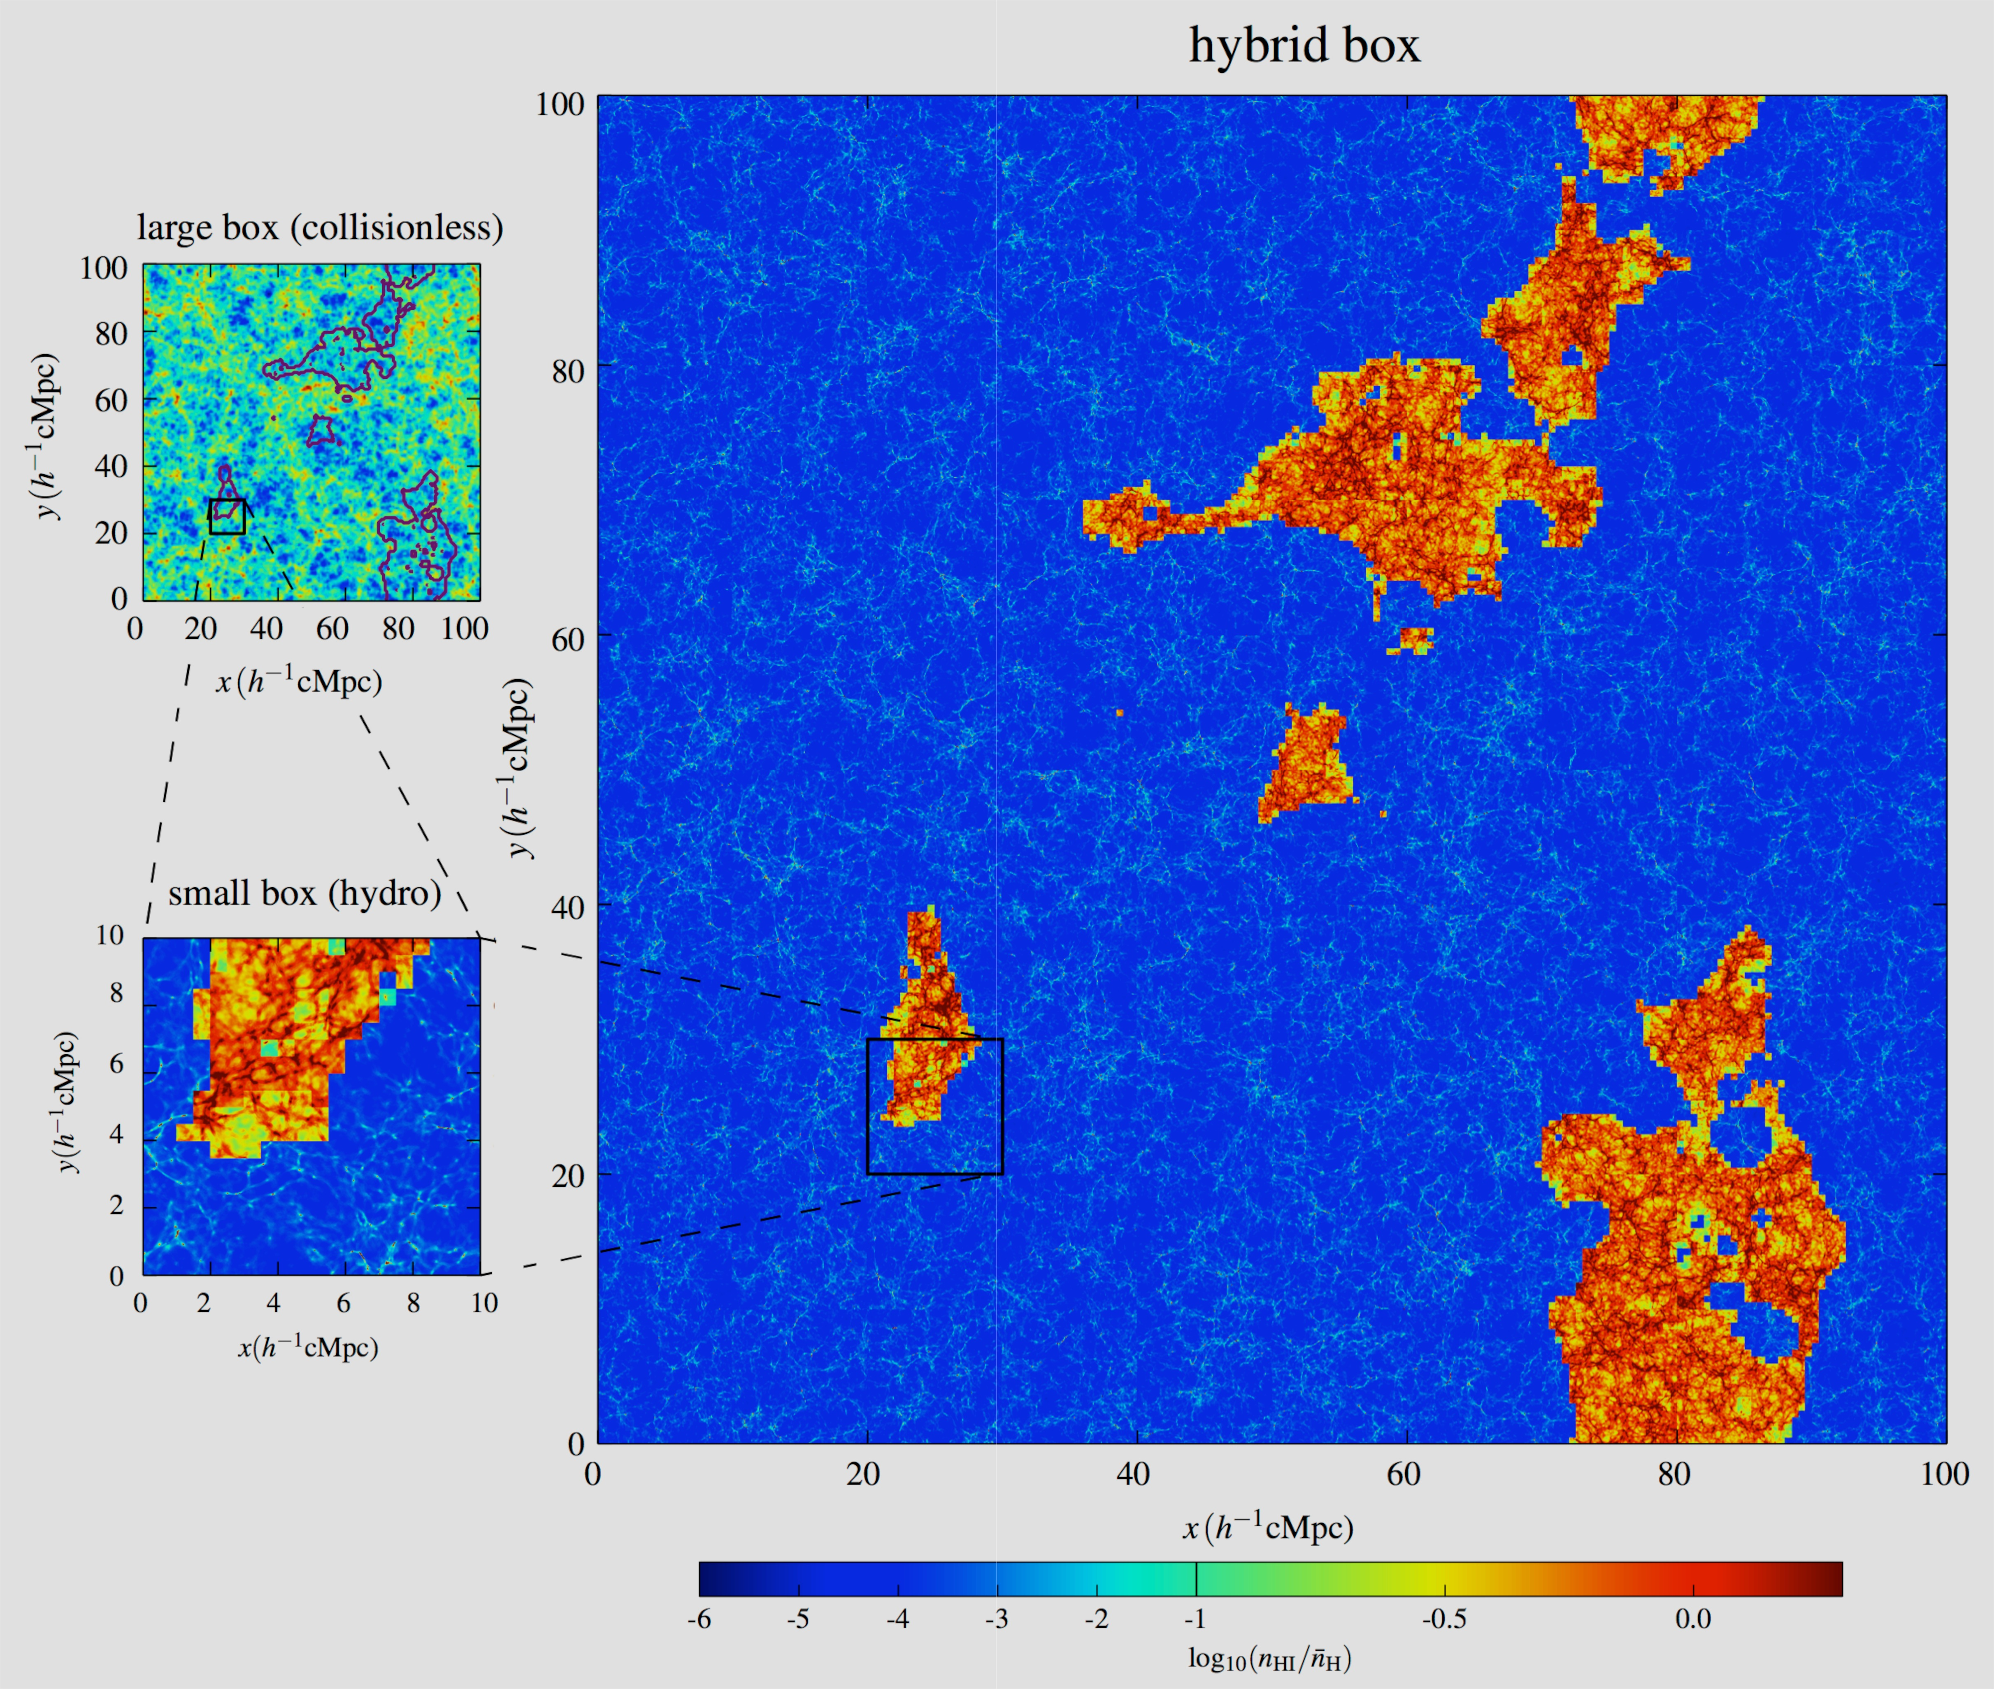
hybrid simulation:
large DM box plus
Small high-resolution
ionized if
ζ_{eff} f_{coll}(x,R) >1

Slide 10
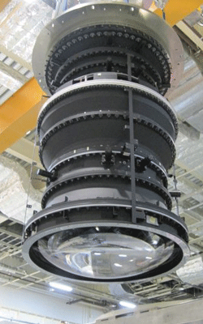
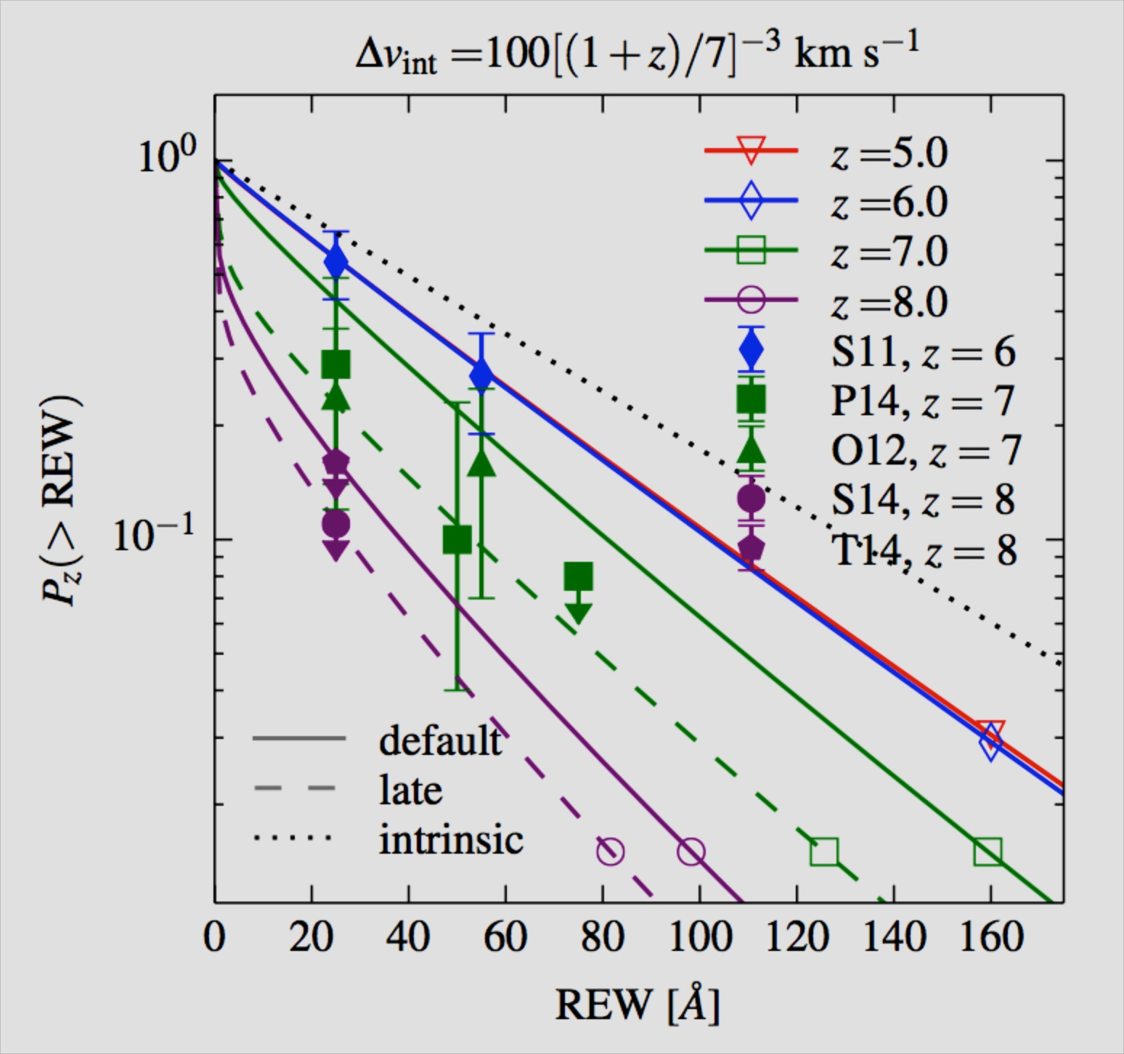
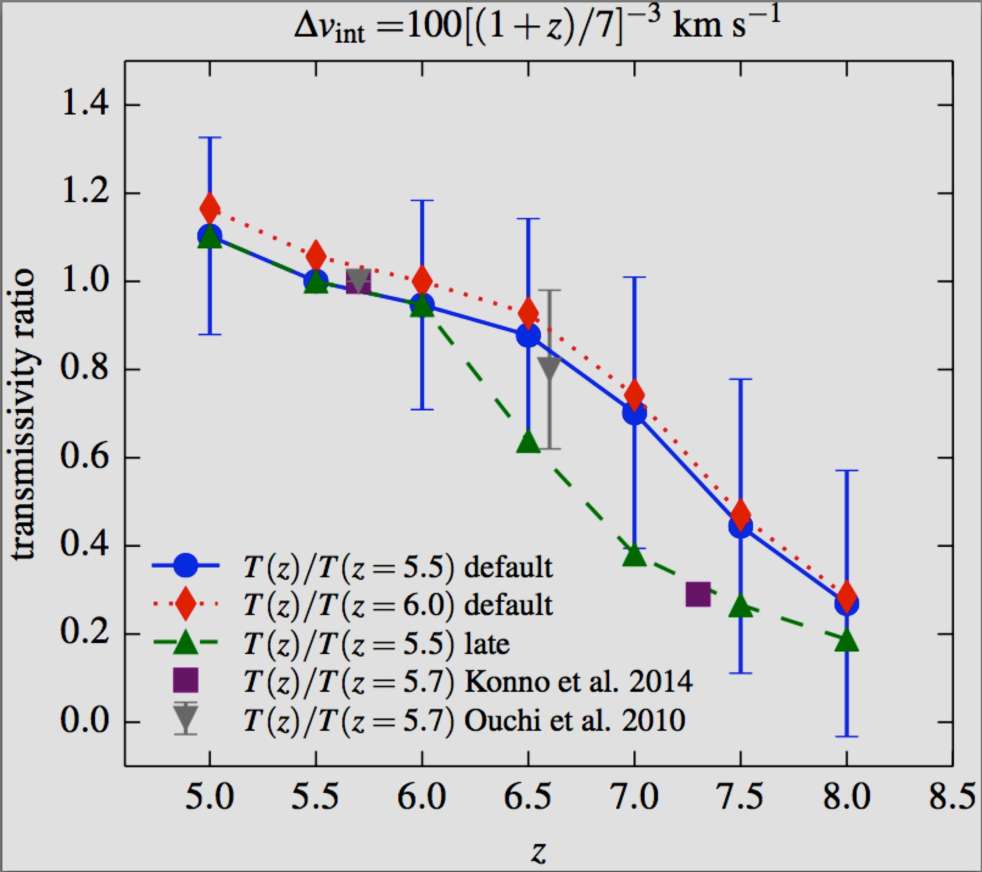
The rapid demise of Lyα emission at z>6
Choudhury, Puchwein,
Haehnelt& Bolton 2015
The rapid decline of Lyα emission at at z>6 requires a (significant) decline of the volume-weighted ionized fraction perhaps aided by an evolution of the intrinsic red offset
Reionization appears to finish (somewhat) later than predicted by HM2012
Should be possible to probe bubble size and topology of reionization
with Hyper Suprime Cam

Slide 11
Sherwood Simulation Suite
Bolton et al. 2016 (in prep.)
2 x 8.5 billion particles
5 runs to z=2, 40 - 160 Mpc/h boxes
15,000,000 core-hours from PRACE
Notes:
Have revisited flux PDF with the Sherwood simulations + some marketing speak

Slide 12
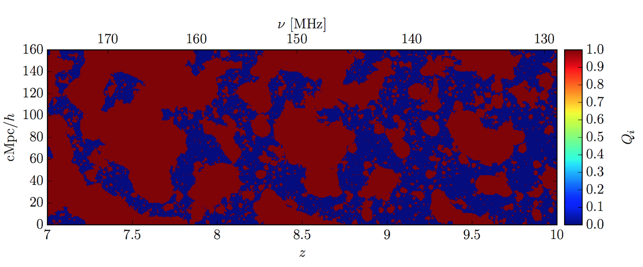
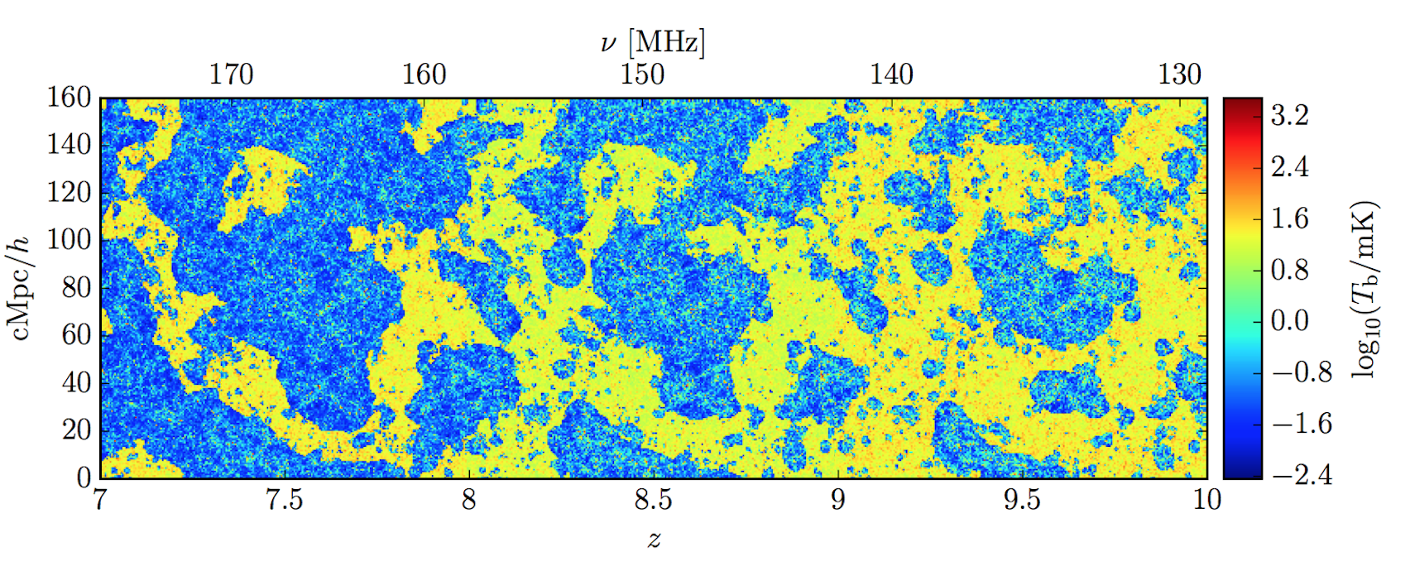
Chouhury et al. 2009, Mesinger et al.2015,
Kulkarni et al. 2016
Self-shielding in the ionized regions is important

Slide 13
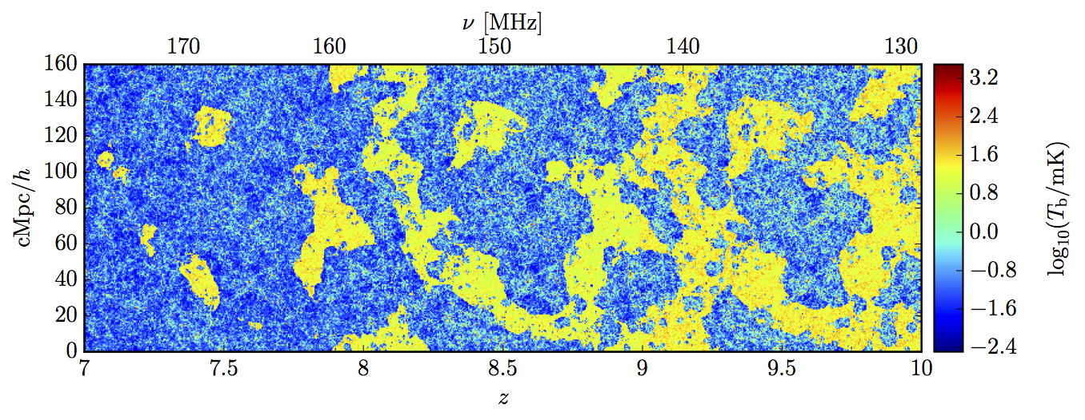
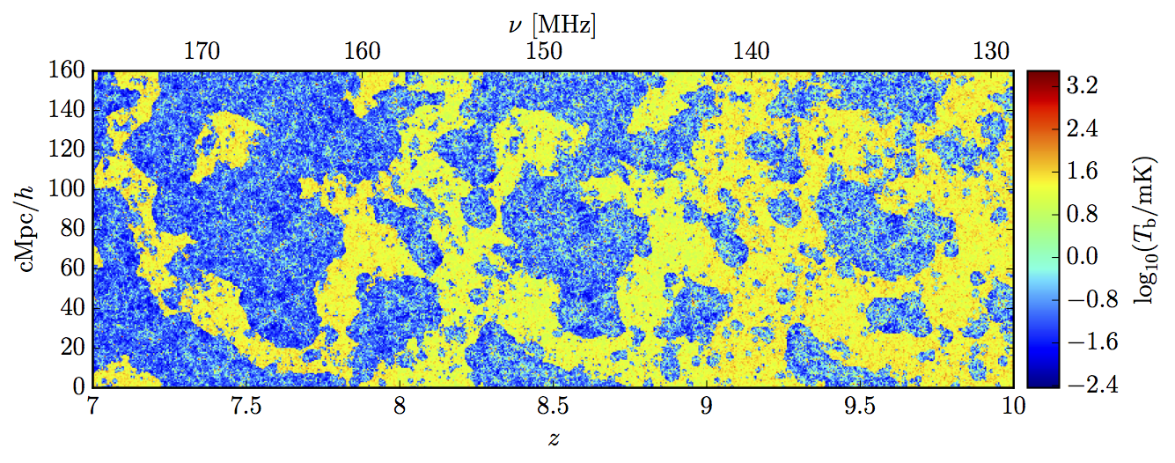
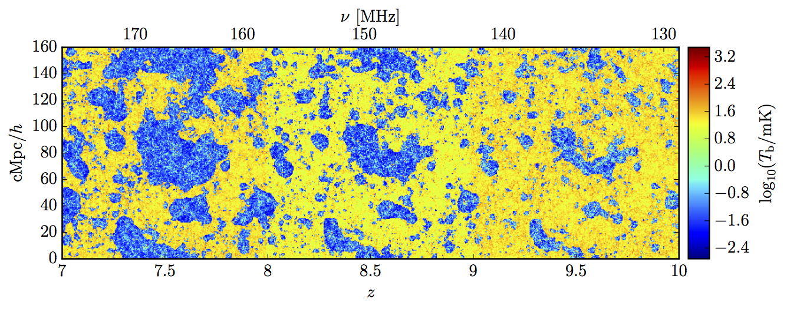
T_{S}>>Tγ
Haardt & Madau 2012
Late
(Chardin et al. 15,16)
Very Late
(Planck 2016?)
Kulkarni et al. 2016

Slide 14
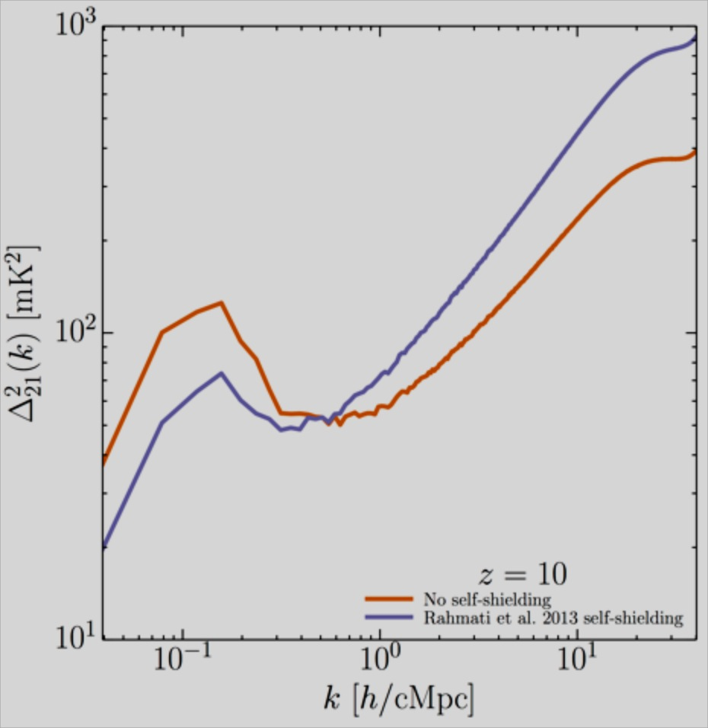
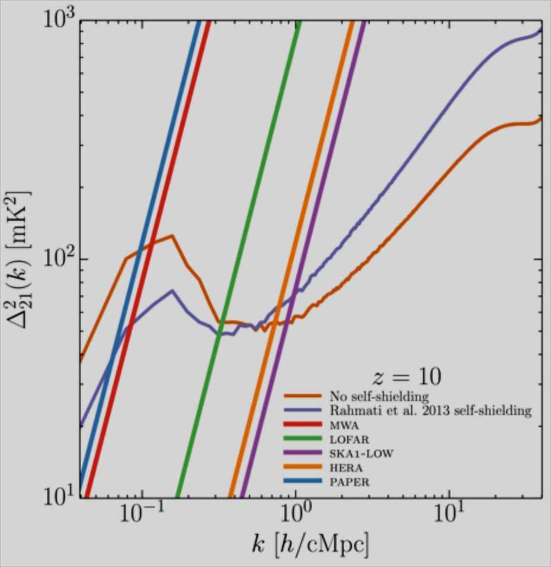
The effect of self-shielded neutral gas in ionized bubbles
decrease on
large scales
increase on
small scales
Kulkarni et al. 2016

Slide 15
Summary
evidence is building for rather late reionization
broad flux PDF at z≈5.6-5.8 may require substantial
contribution of QSOs to photoionization rate
calibration of reionization models with Lyα absorption/emission data is possible and important
Self-shielded neutral gas is important both at the onset and
in particular at the end and in the post-overlap phase of
reionization

Slide 16
Topics for discussion
What input is needed to further influence SKA design?
What is needed to convince wider Astronomy community of a detection?
How important will be cross-correlation of 21cm with other observational probes? Which?

Slide 17
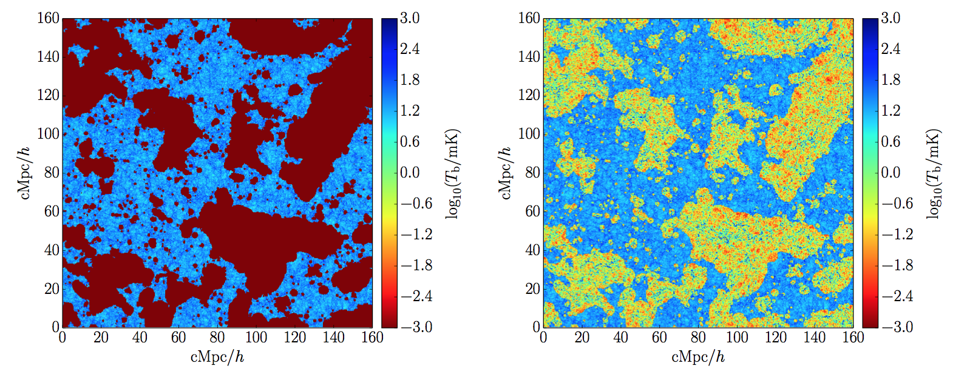
Kulkarni et al. 2016

Slide 18
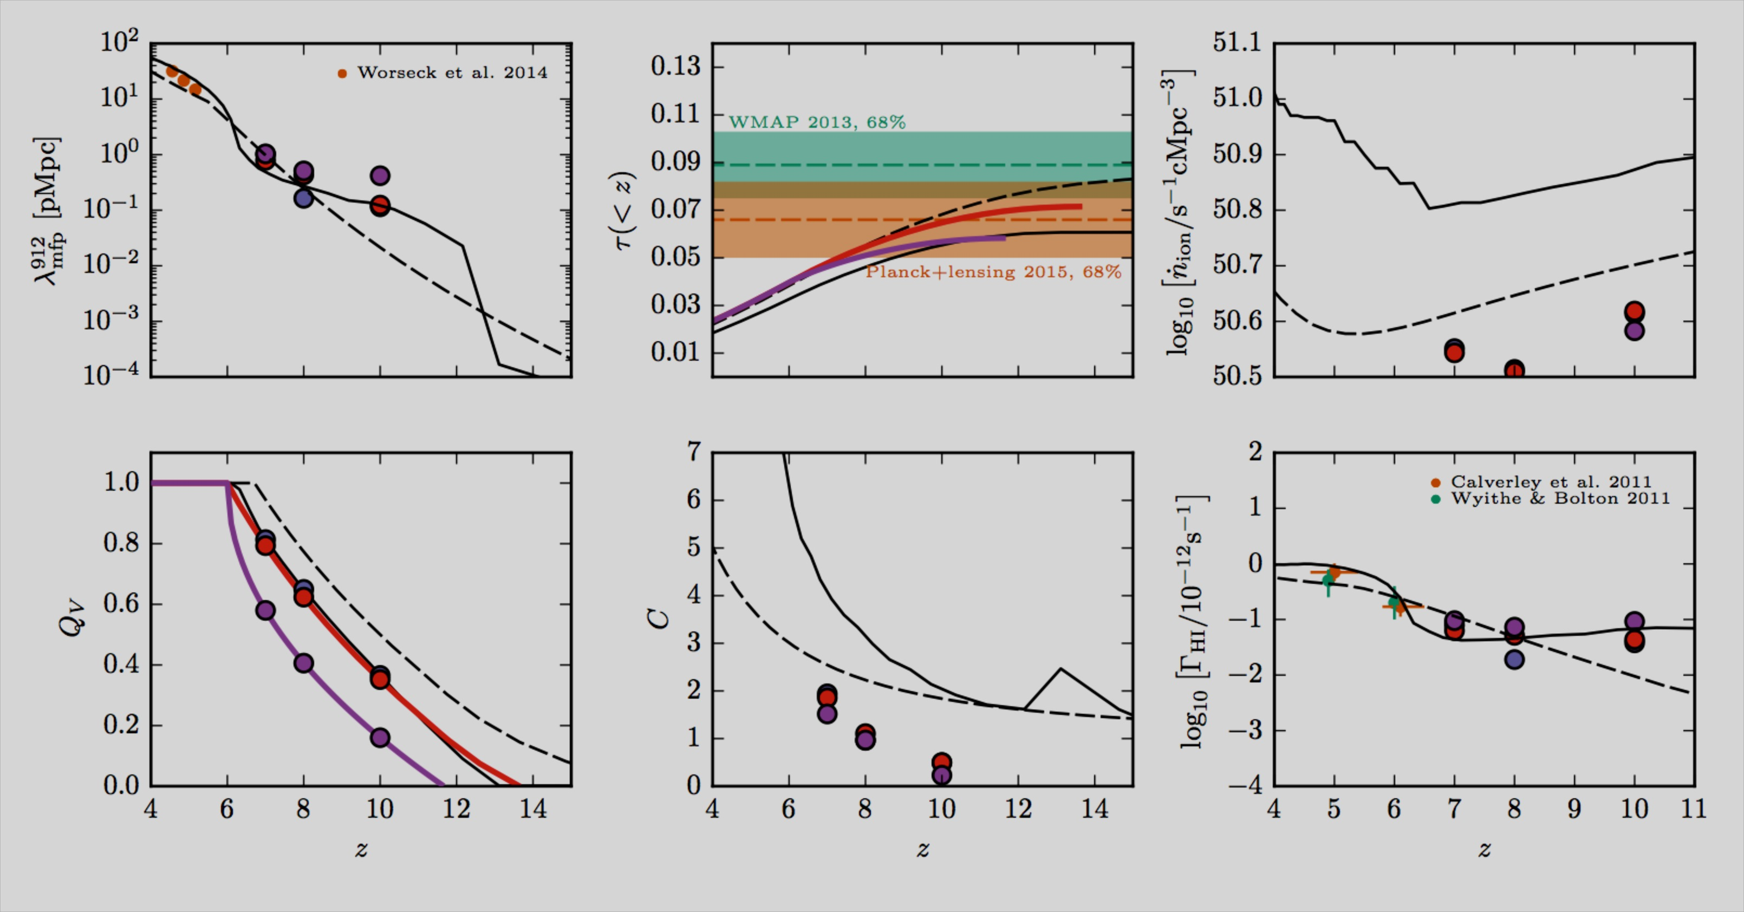
Kulkarni et al. 2016

Slide 19
Kulkarni et al. 2016

Slide 20
Kulkarni et al. 2016

Slide 21
Kulkarni et al. 2016

Slide 24
Lyman-α emission from
high-redshift galaxies

Slide 26
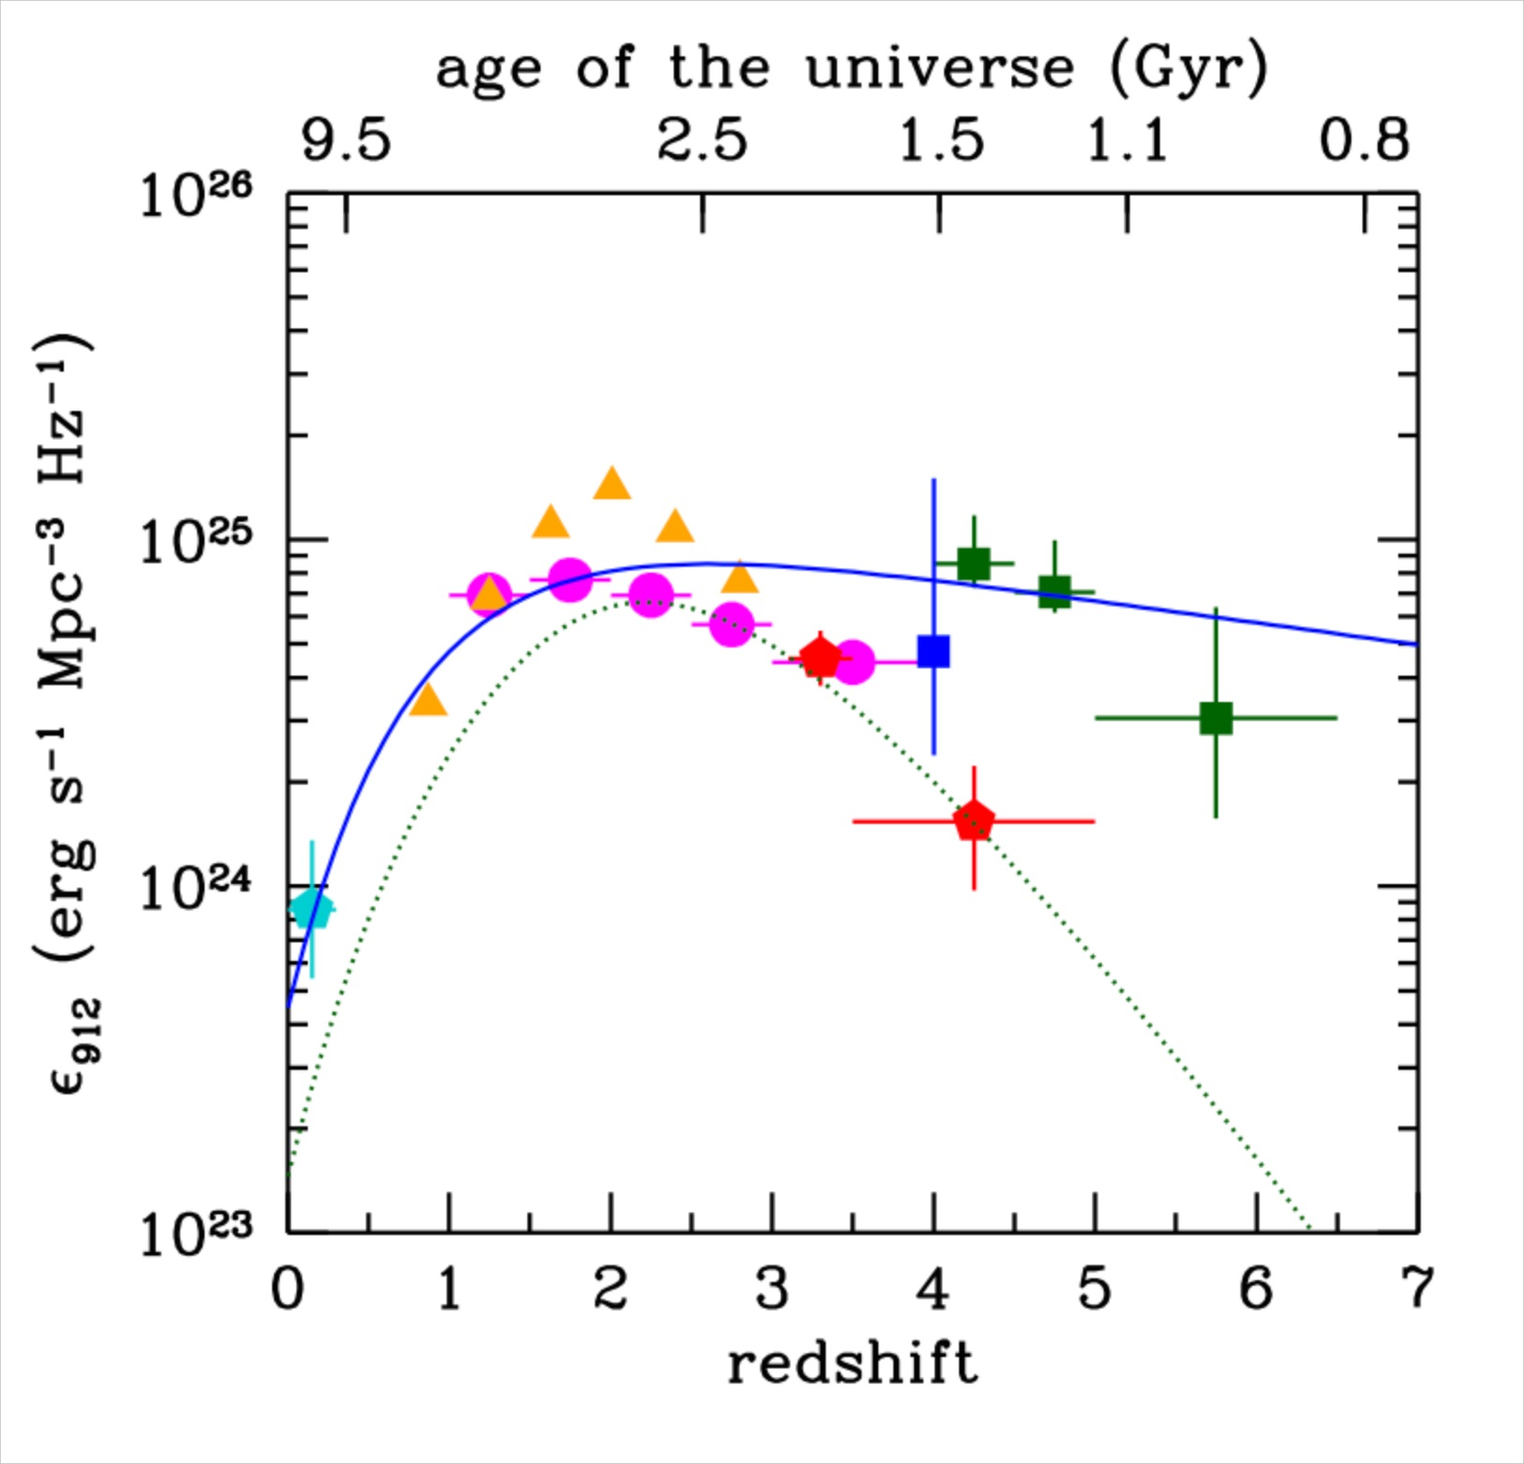
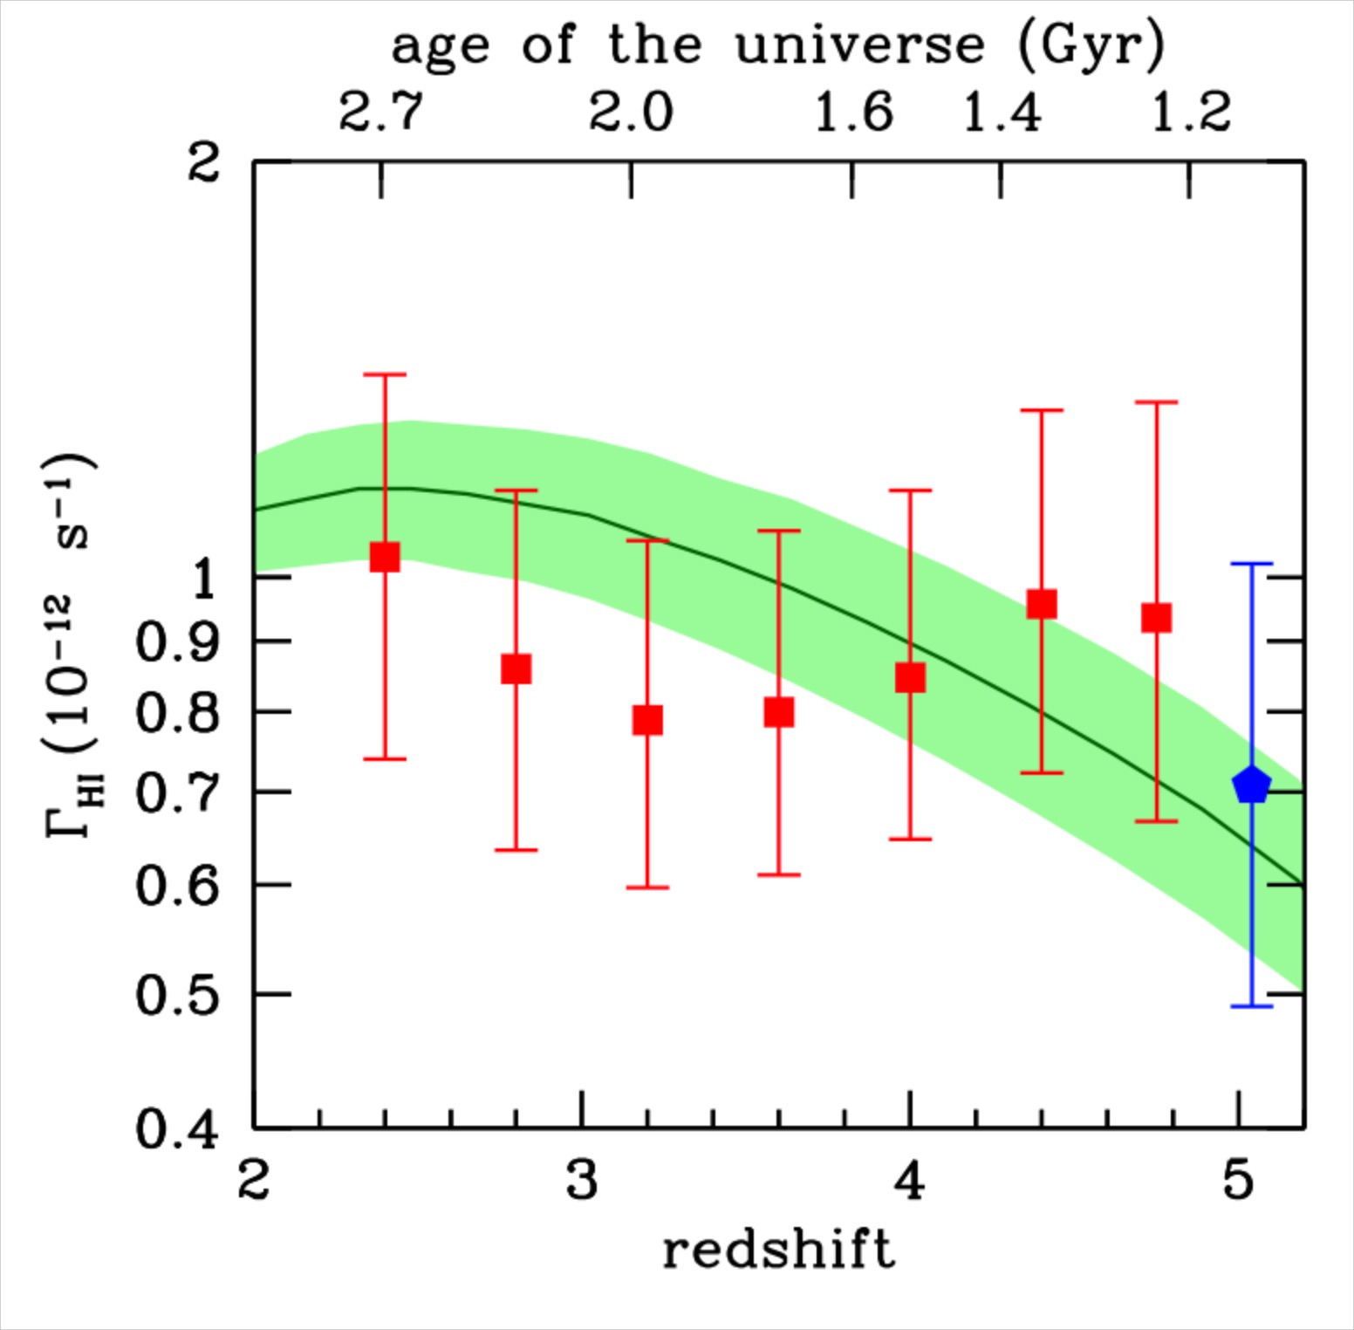
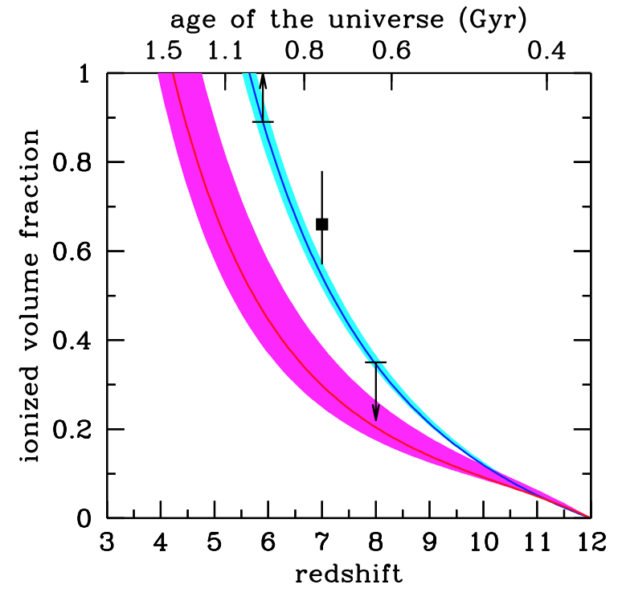
Dropping galaxies alltogether is perhaps a bit radical. Soft X-ray background probably OK. Implications for helium reionization still to be explored.

Slide 27
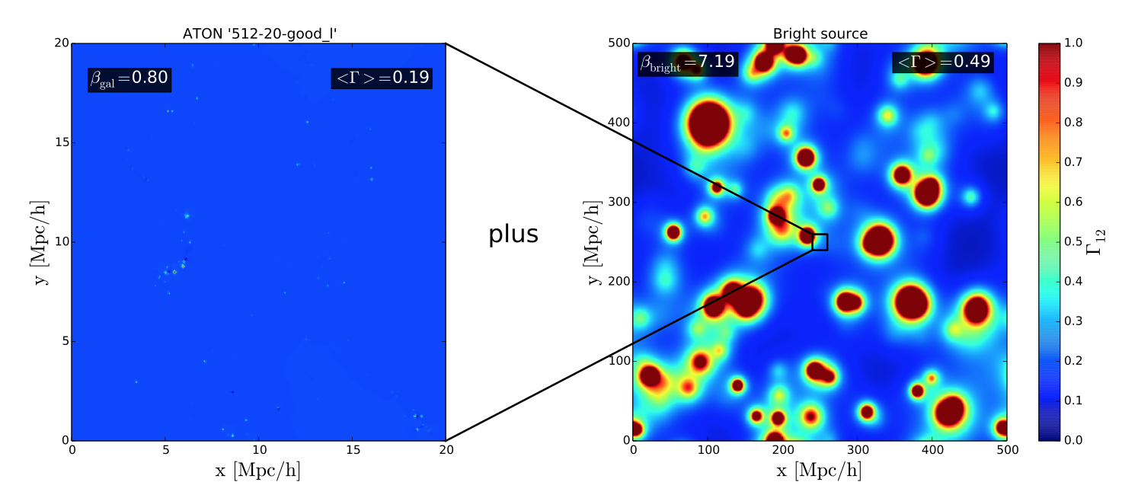
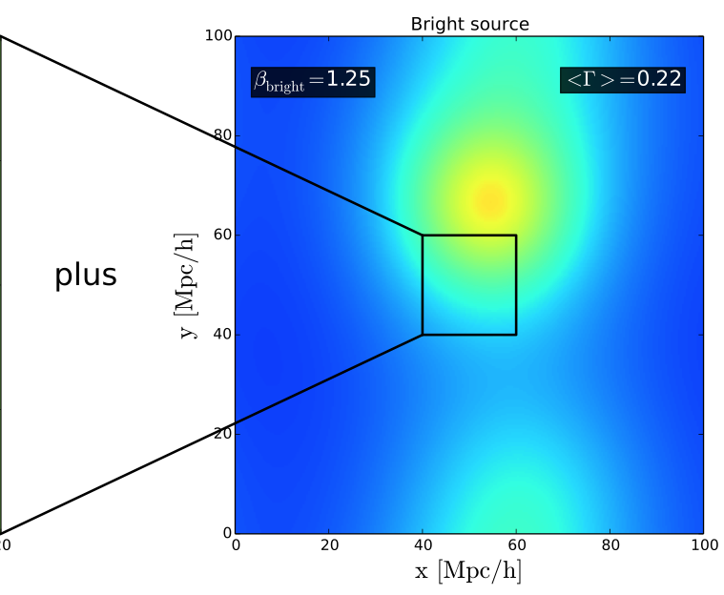
Galaxies only
Galaxies plus QSOs
z=5.8
Large scale fluctuations of the photo-ionization rate due to L* QSO?

Slide 28
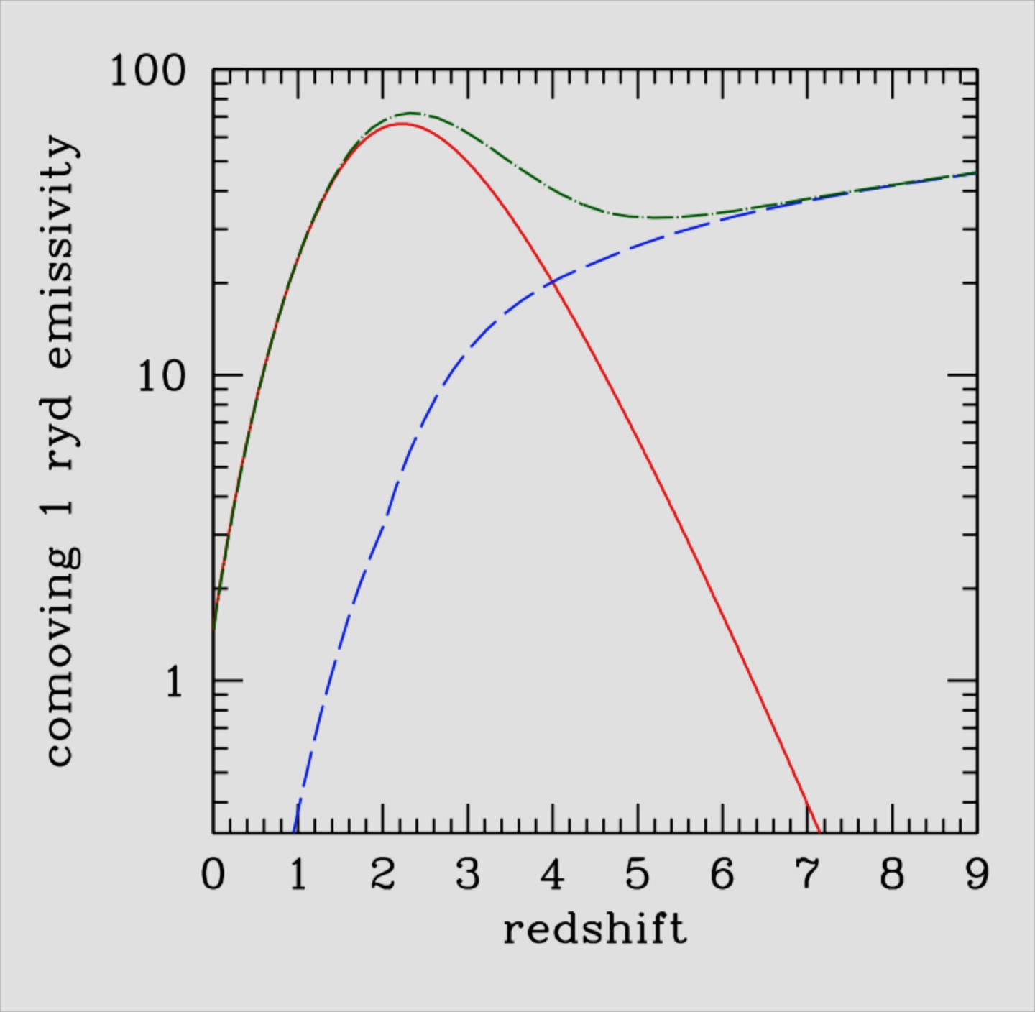
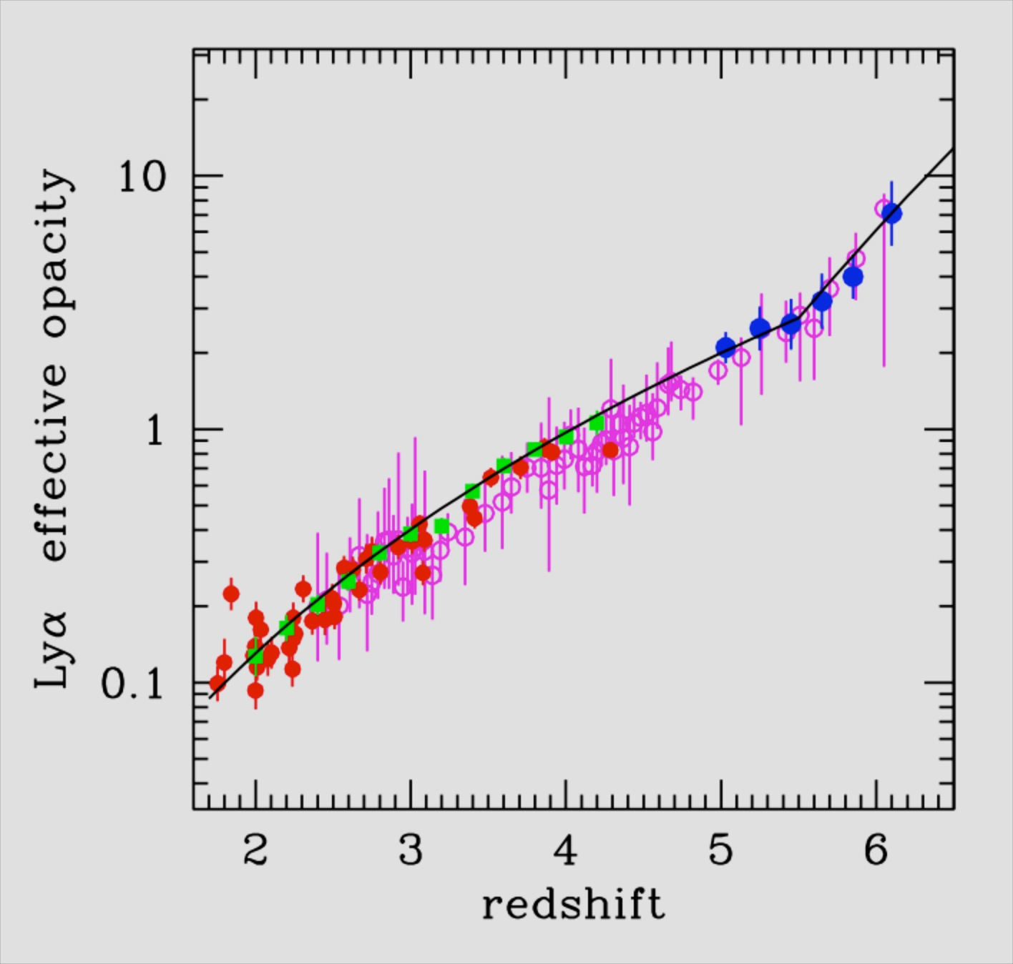
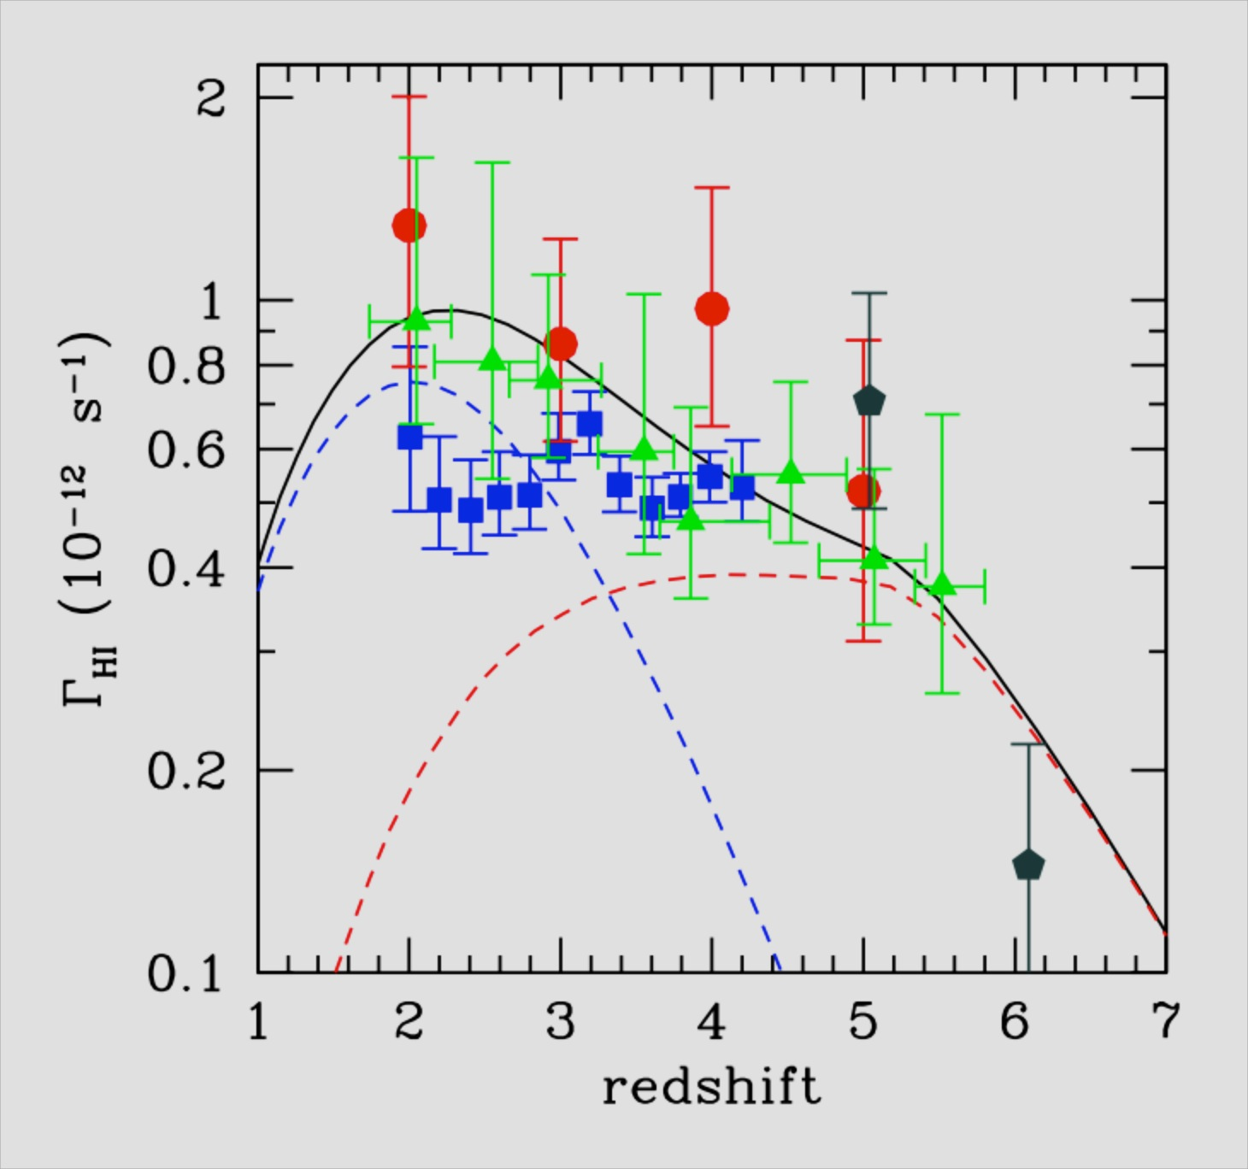
HM2012 – The benchmark model
τ_{eff}
QSOs
galaxies
photo-ionization
rate
ionizing
emissivity
This assumes reionization is driven by faint! galaxies

Slide 29
Models where half (or more) of the photo-ionization rate at z ~5.6-5.8
is contributed by QSO fit the PDF as measured by Becker et al. very well.

Slide 30
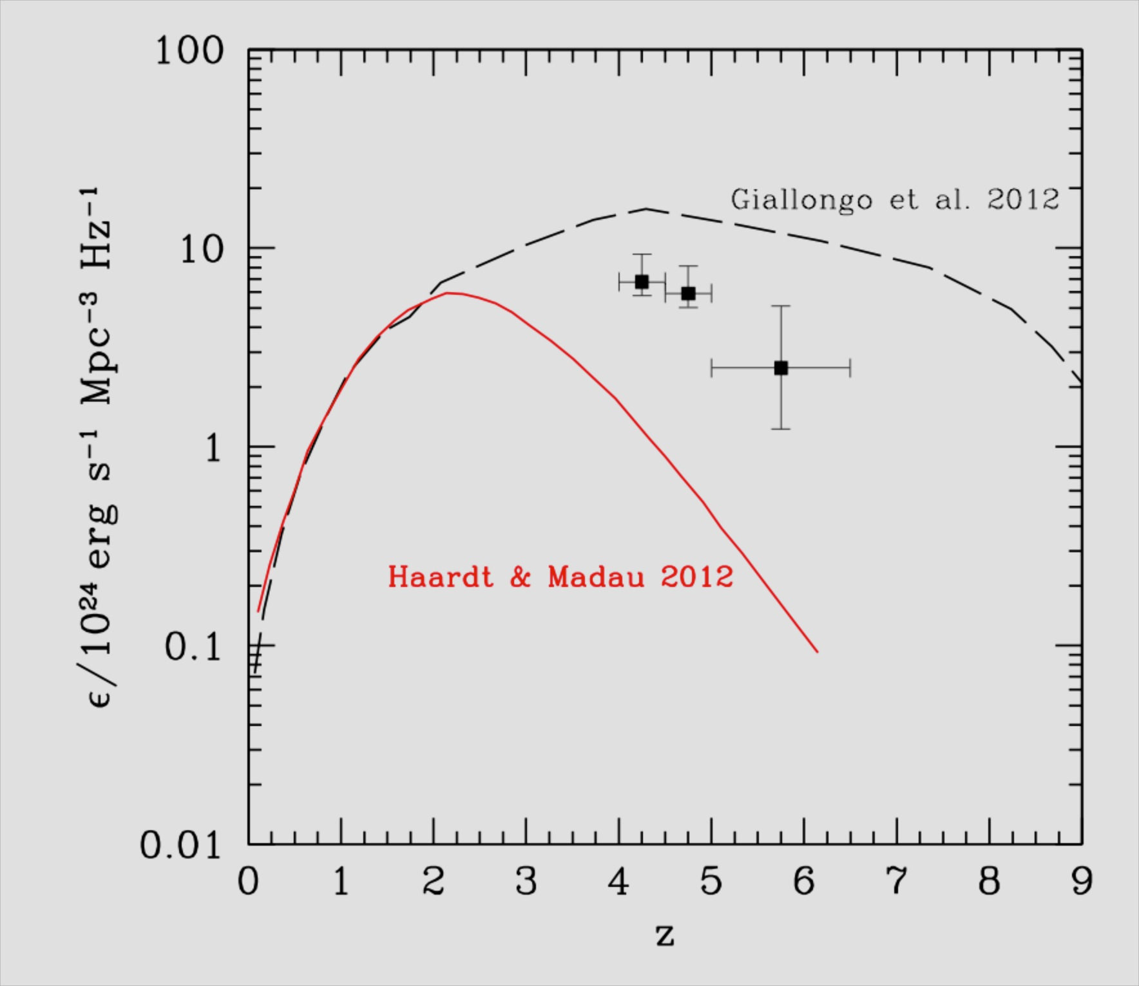
QSOs
galaxies
ionizing
emissivity
Giallongo et al. 2015
This probably needs some modification.

Slide 31
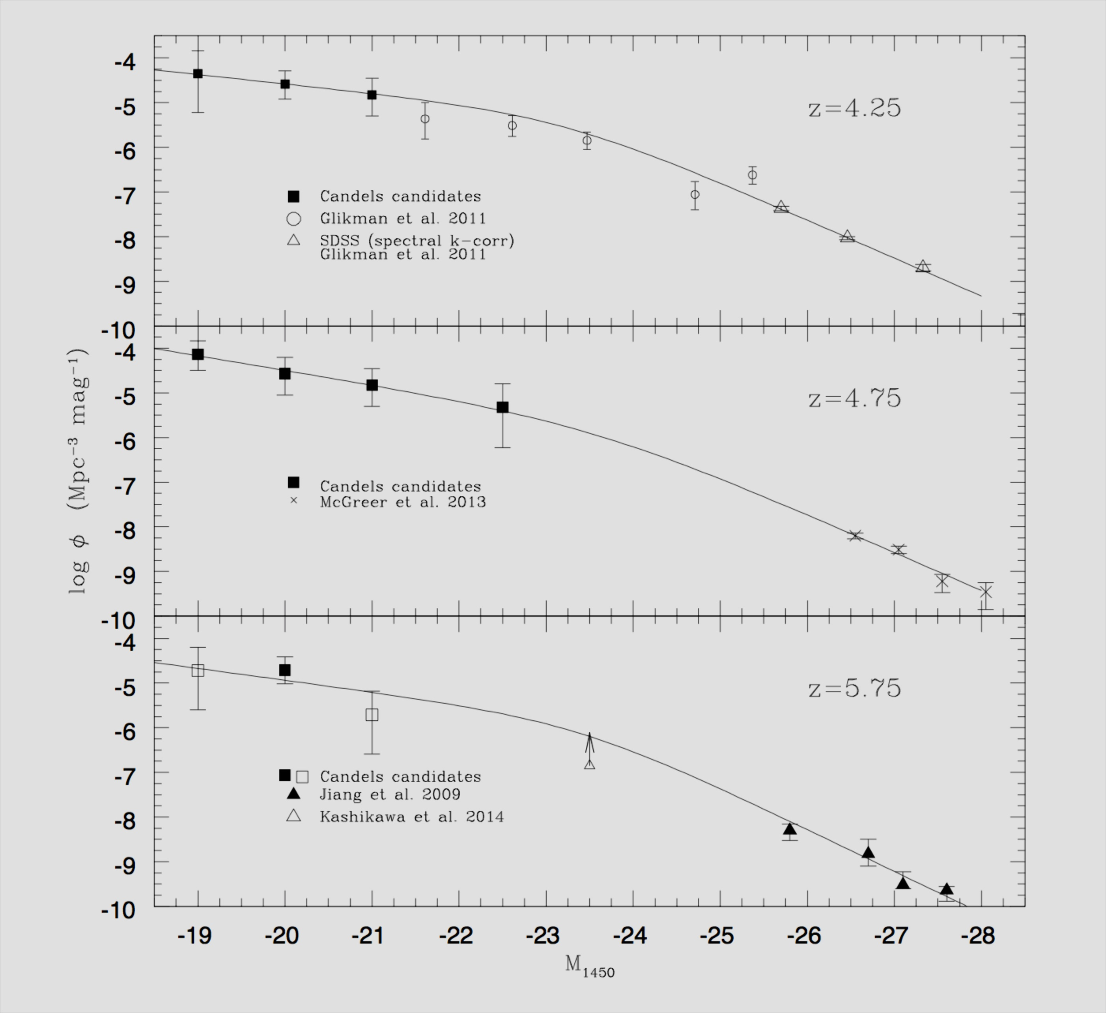
QSO luminosity function
not well
constrained
Giallongo et al. 2015

Slide 32
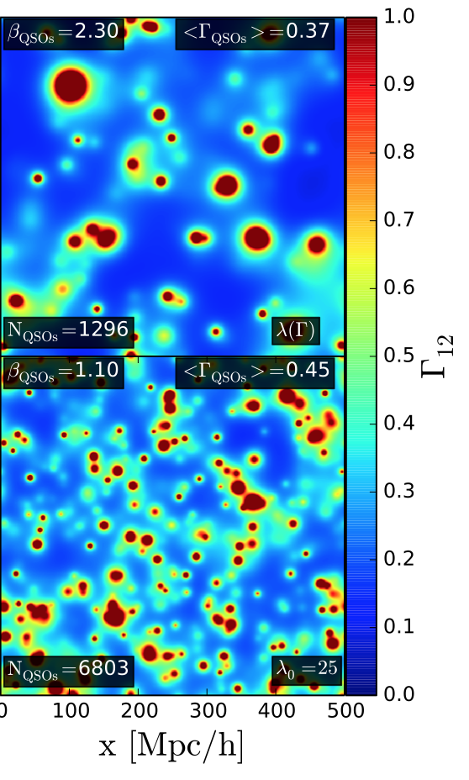
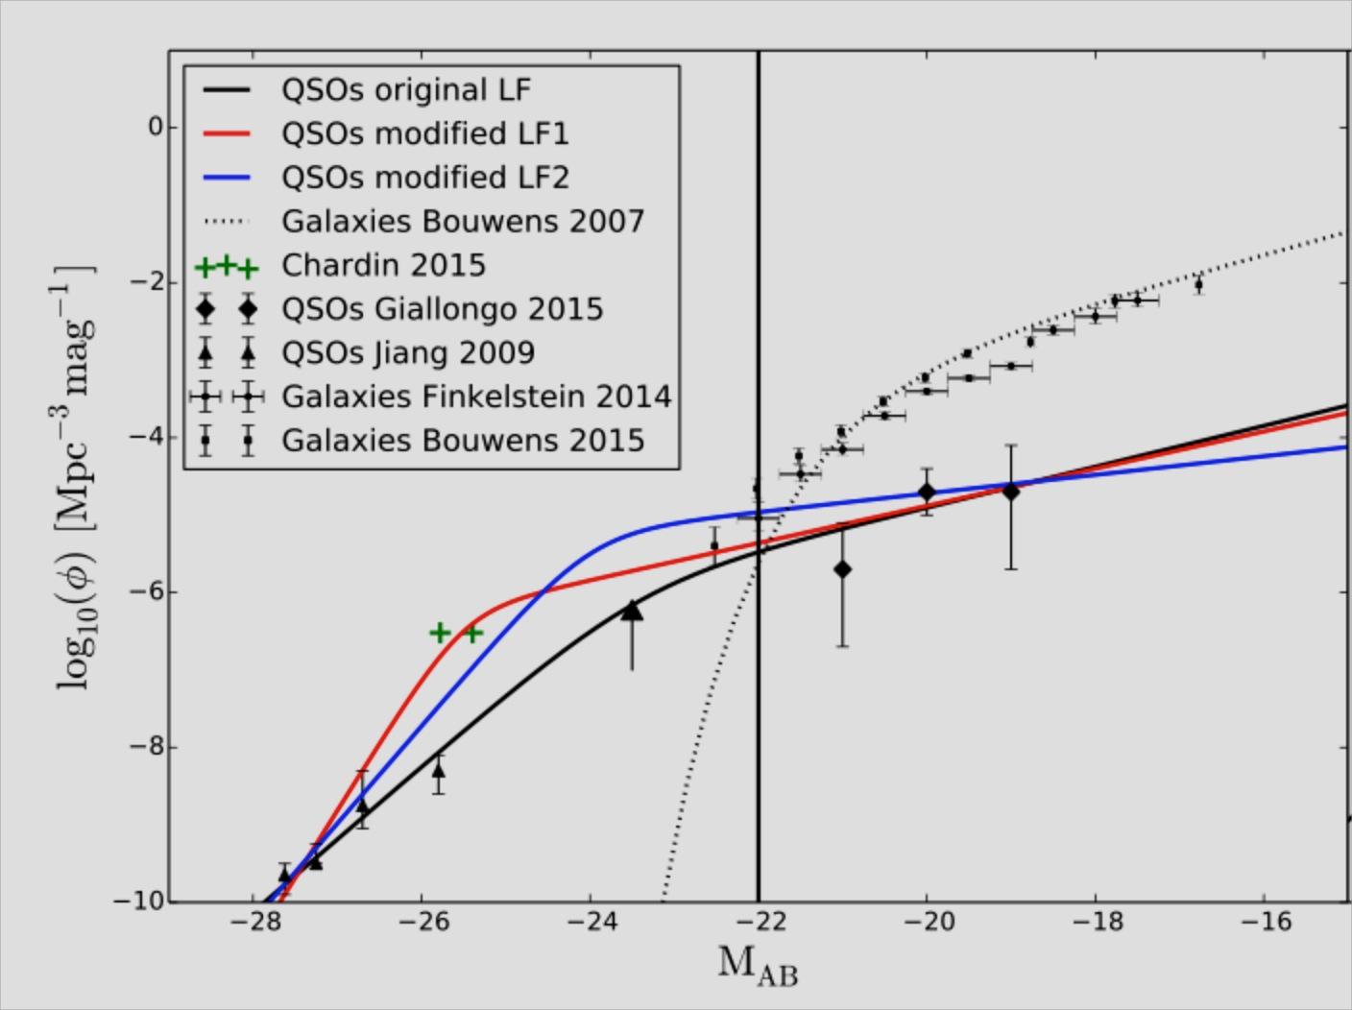
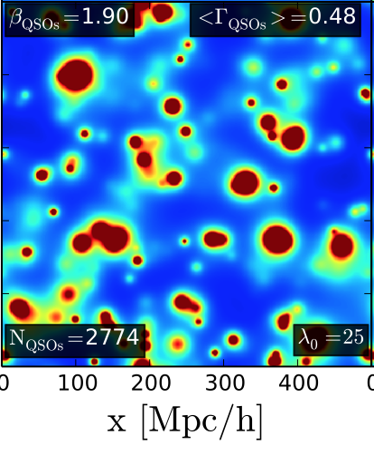
For fixed mean free path λ_{mfp} the
required Φ* L* for QSOs is somewhat
Higher than inferred from
Giallongo et al.2015, but it
becomes consistent if the effect of
the photoionization rate fluctuations
of the QSO on the mean free path
are taken into account.
Chardin et al. 2016 (in preparation)

