Slide 1
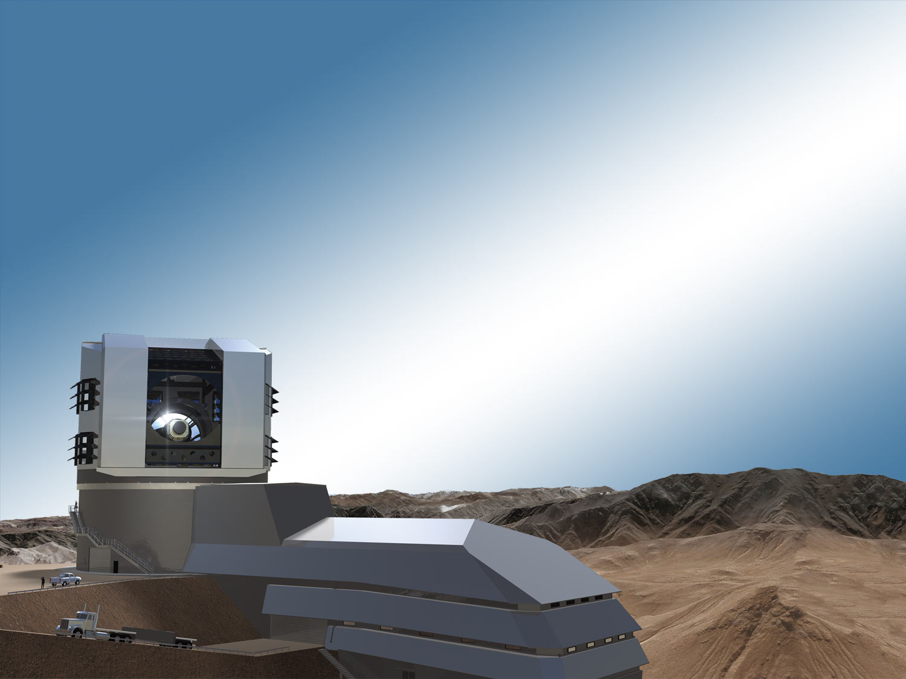
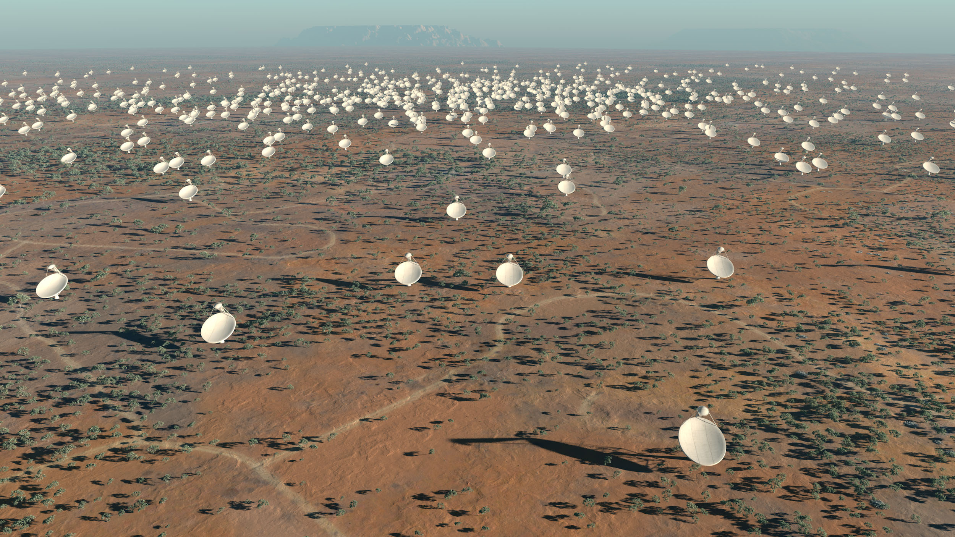
Computational synergies
between LSST and SKA
Bob Mann
University of Edinburgh
LSST:UK Project Leader
www.lsst.ac.uk

Slide 2
Synergies between LSST & SKA
Scientific synergies
  Bacon et al (arXiv: 1501.03977) summarise synergies from cosmology, galaxy evolution, transients
  UK in unique position to exploit the combination of SKA and LSST (and Euclid)
Computational synergies (& complementarities)
  Both technical and political/financial
  Now is the time to start discussing details

Slide 3
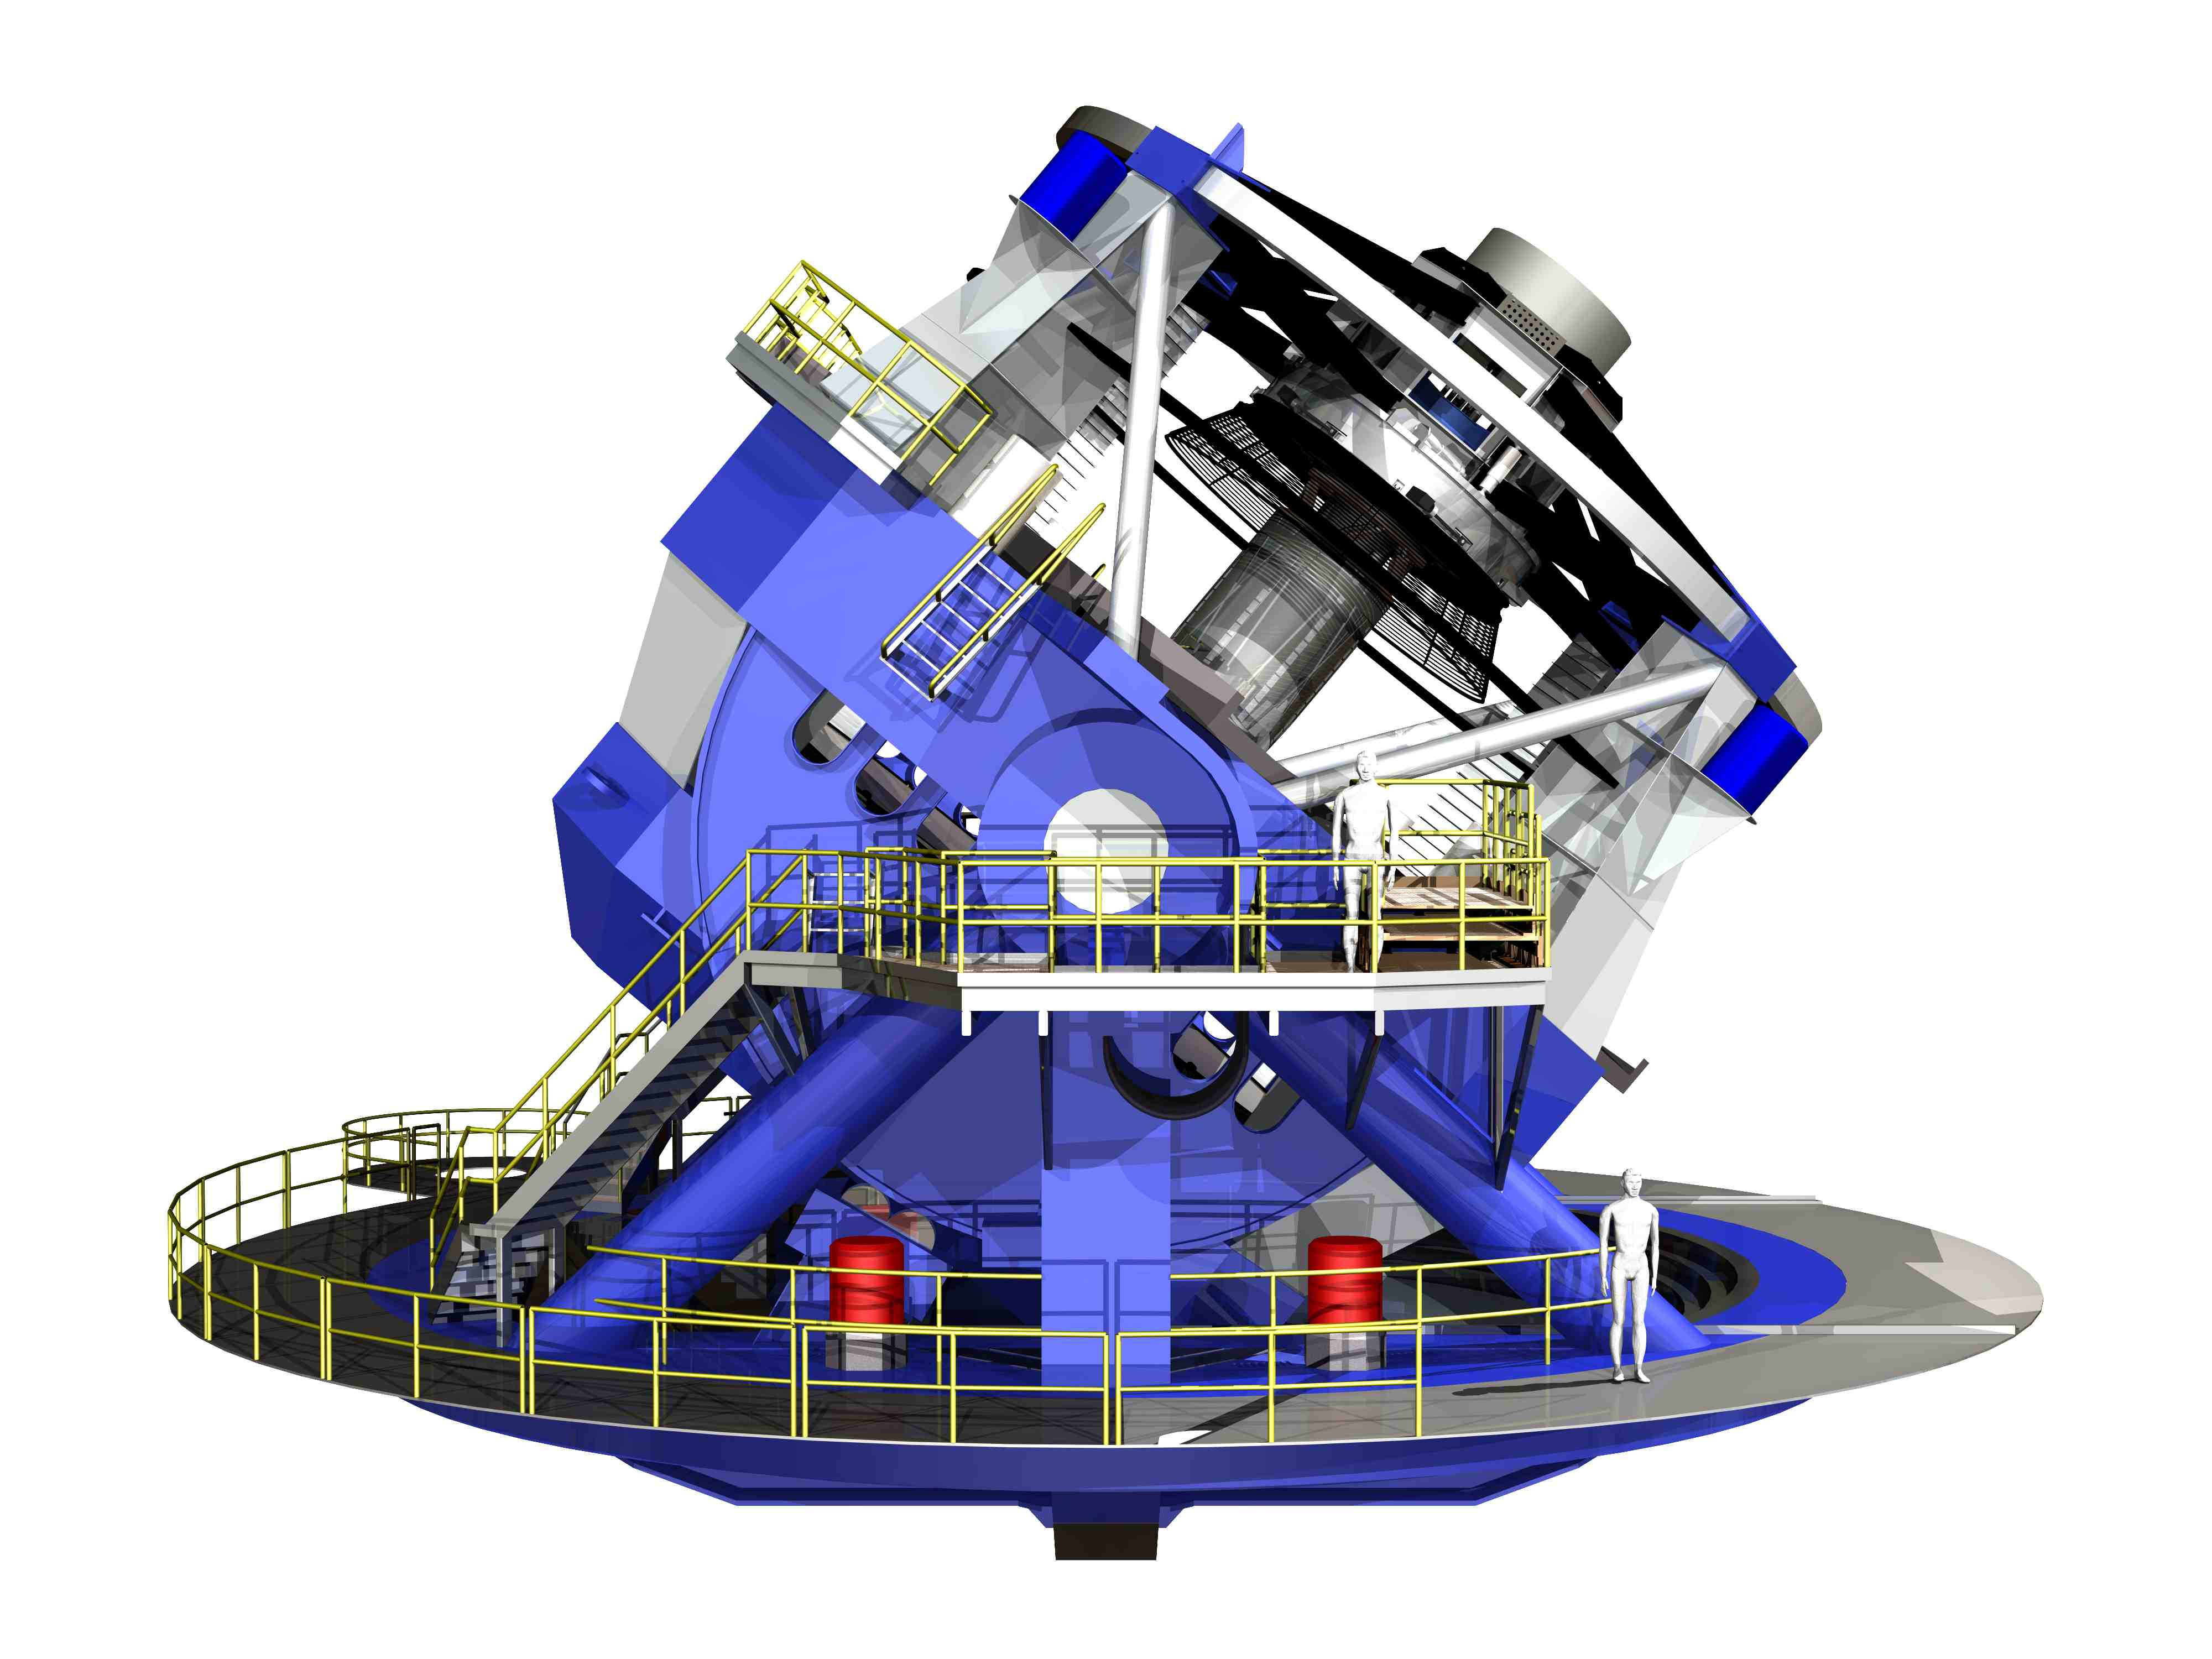
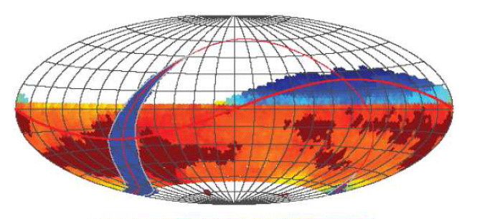
LSST Basics
Large optical survey telescope to be located in Chile
  annular primary 6.5m effective; 9.6 sq. deg FOV
Ten year survey from ~2022
US-led: NSF + DoE (camera)
plus foreign partners
Four science themes
  Probing dark energy and dark matter
  Mapping the Milky Way
  Exploring the transient optical sky
  Taking an inventory of the solar system
system design: Ivezic et al (arXiv:0805.2366)

Slide 4
High-level survey requirements
Survey Property | Performance
Main Survey Area | 18000 sq. deg.
Total visits per sky patch | 825
Filter set | 6 filters (ugrizy) from 320 to 1050nm
Single visit | 2 x 15 second exposures
Single Visit Limiting Magnitude (5σ point source, AB) | u = 23.9; g = 25.0; r = 24.7; i = 24.0; z = 23.3; y = 22.1
Integrated limiting mag (5σ ps, AB) | u = 26.3; g = 27.5; r = 27.7; i = 27.0; z = 26.2; y = 24.9
Photometric calibration | < 2% absolute, < 0.5% repeatability & colors
Median delivered image quality | ~ 0.7 arcsec. FWHM
Transient processing latency | < 60 sec after last visit exposure
Data release | Full reprocessing of survey data annually

Slide 5
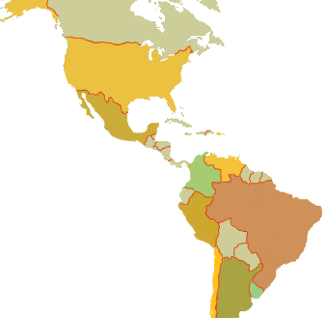
Data Products: Level 1 – nightly processing
Archive Site
Difference Imaging
Alerts within < 60 sec
Solar System orbits < 24h
10⁶ alerts per night:
need “event broker”
at NCSA to filter these
Summit Site
Base Site

Slide 6
Data Products: Level 2 – annual data release*
French Site
Processing Center
  Data Release Production
Archive Site
Processing Center
Data Release Production
Data Access Center
Data Access and User Services
UK Site
Data Access Center
  Data Access and User Services
All extant data included:
per-visit images
per-visit catalogues
co-add images
co-add catalogues
Per-visit forced photom.
Base Site
Data Access Center
Data Access and User Services
Summit Site
* Twice in Year 1

Slide 7
Data Products: Level 3 – user-created products
French Site
Processing Center
  Data Release Production
Archive Site
Processing Center
Data Release Production
Data Access Center
Data Access and User Services
Beyond requirements
of LSST project delivery:
needed for much science
mainly coordinated through
Science Collaborations
may be incorporated into L2
UK Site
Data Access Center
  Data Access and User Services
Base Site
Data Access Center
Data Access and User Services
Summit Site

Slide 8



UK participation in LSST
LSST:UK
Consortium
Defines the
programme
of work for…
Works on
behalf of…
LSST:UK Science Centre (LUSC)

Slide 9
Timeline for LSST and LUSC
Phase A:
Development
Phase B:
Commissioning
Phase C:
Early Ops.
Phase D:
Standard Operations
LUSC
2014 | 2015 | 2016 | 2017 | 2018 | 2019 | 2020 | 2021 | 2022 | 2023 | 2024 | 2025 | 2026 | 2027 | 2028 | 2029 | 2030 | 2031 | 2032 | 2033
1 August 2014: start of construction project
October 2019: telescope First Light
October 2022: start of main survey operations
September 2032: end of main survey

Slide 10
Phase A funding from PPRP
£15M set aside for operations contribution
Phase A programme (July 2015 – March 2019)
  LUSC-DAC (Data Access Centre prep): 6 staff-years
    DAC testbed, Data Challenges, supporting LUSC-DEV (Edin)
  LUSC-DEV (Level 3 prep/development): 16 staff-years
    Weak lensing: sims., PSF, deblending, Euclid synergy (Man/Oxf/UCL)
    Milky Way: star/galaxy separation, tidal stream detection (Cam)
    Transients: alert handling, classification, cadence (QUB/UCL/Soton)
    Solar System: postage stamps, lightcurves (QUB)
    Sensor characterisation: image analysis systematics (Oxf)

Slide 11
UK Data Access Centre
Supporting UK community’s use of LSST data
Provide access to Level 1 and 2 data products
  Generated in the US and France
Ingest and serve ancillary datasets
Support running of Level 3 data analysis
  Providing LSST software stack & environment
  Providing compute and storage facilities
  Operating helpdesk, etc
Likely to be a coordinated network of DACs
  Details unclear as yet…

Slide 12
UK DAC computational requirements
DACs similar to the SKA Regional Centres
  But with smaller computational requirements
Expectations:
  Database: ~2PB in 2022 growing to ~31PB in 2032
  Images*: ~30-50PB flat file storage
  Compute*: ~20 TFlops in 2022 ➔ ~140TFlops in 2032
  *Very uncertain: depend on science goals and degree of coordination between DAC network

Slide 13
UK LSST/SKA synergies
Scientific pull
  Joint analyses: e.g. weak lensing, transients
Political/financial push
  STFC want common computing infrastructure across the PPAN area
    Extension of GridPP?...or something cloudy?
  Both projects need to understand how well they could fit a generic model and whether they share specific requirements – e.g. multi-PB databases

Slide 14
UK LSST/SKA complementarities
Focus on different computational challenges
  SKA: bulk processing, data transport
  LSST: large databases, high transient rates
Can we share expertise?
Can we coordinate astro requirements for proposed STFC computing infrastructure?

Slide 15
Summary
Strong scientific synergies
  Key contacts: Sarah Bridle (LSST:UK PS),
  David Bacon (LSST:UK SKA Liaison)
Potential for technical collaboration
  Key contacts: Bob Mann (LSST:UK PL),
  George Beckett (LSST:UK PM)
Now is time to start discussing details
  Plans for DACs and Regional Centres are taking shape
  Future of STFC computing under discussion

Slide 17
LSST:UK Science Working Group
Chair: Sarah Bridle (LSST:UK Project Scientist)
Liaisons with other projects
Points of Contact with LSST Science Collaborations
Dark Energy Theory PoC: Jo Dunkley
Photo-z Calibration PoC: Ofer Lahav
Cosmological Simulations PoC: Carlton Baugh
Transients & Variable Stars PoC: Stephen Smartt
Solar System Science PoC: Wes Fraser
Galaxies Science PoC: Sugata Kaviraj Informatics & Statistics PoC: Jason McEwen
Variable Stars PoC: Aleks Scholz
Star Clusters PoC: Tim Naylor
Magellanic Clouds PoC: Maria-Rosa Cioni
Galactic Bulge PoC: Victor Debattista
Low-mass stars PoC: Ben Burningham
Galactic Structure PoC: Vasily Belokurov
AGN Point of Contact: Carole Mundell
Particle Physics Liaison: Ian Shipsey
Infra-Red Liaison: Manda Banerji
Spectroscopy Liaison: Richard McMahon
SKA Liaison: David Bacon
Gaia Liaison: Nic Walton
E-ELT Liaison: Isobel Hook
Euclid Liason: Bob Nichol
Athena Liaison: Mike Watson
Weak Lensing Point of Contact: B. Joachimi Large Scale Structure PoC: Jon Loveday
Supernovae Point of Contact: Mark Sullivan
Clusters Point of Contact: Graham Smith
Strong Lensing Point of Contact: A. Verma

Slide 18
DAC Data Volumes
Image files
Databases
  ~38 billion distinct objects (24B gals, 14B stars) observed ~1000 times ➔~38 trillion sources

Slide 19
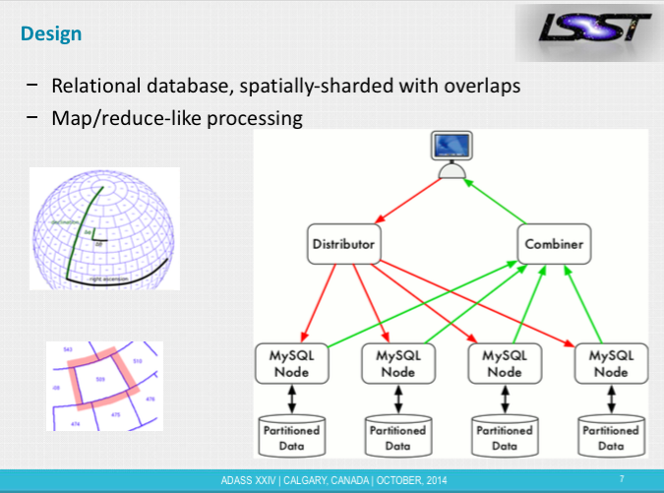
Database design
Nodes
connected
by xrootd

Slide 20
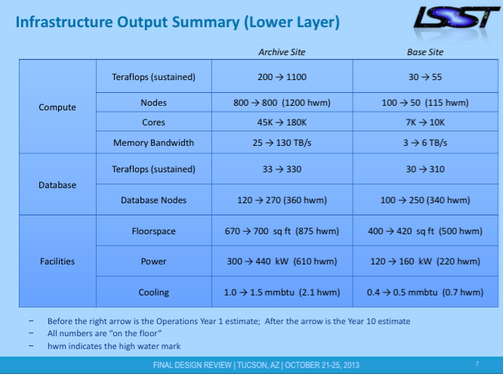
Computing requirements
Compute
LSST assume DAC will need ~10% for Level3:
i.e. ~20-140 Tflops

Slide 21
Pre-operations computing
LUSC-DEV: Algorithm development
  Using simulations and data from other surveys
LUSC-DAC: Prototyping DAC operations
  Data ingest and query workload
  Supporting large-scale analyses of images & DBs(?)
Quantitative requirements will become clear over the next year or so
  Lessons from DES (Joe Zuntz) & Euclid (Keith Noddle)

Slide 22
LSST Budget
US agencies – NSF and DoE
  Construction: ~$640M
  Operations: ~$270M out of ~$370M
International partners must contribute ~$100M
  Default model: ~$200k per P.I. inc. students/postdocs
  Plus extra ~10% for additional load on DAC system
  or operate own DAC

